Slide 1
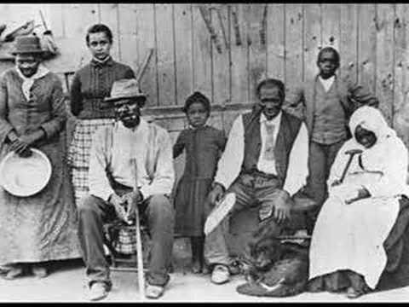
AFRICAN-AMERICAN SPIRITUALS:
SLAVERY’S UNCHAINED MELODIES

Slide 2
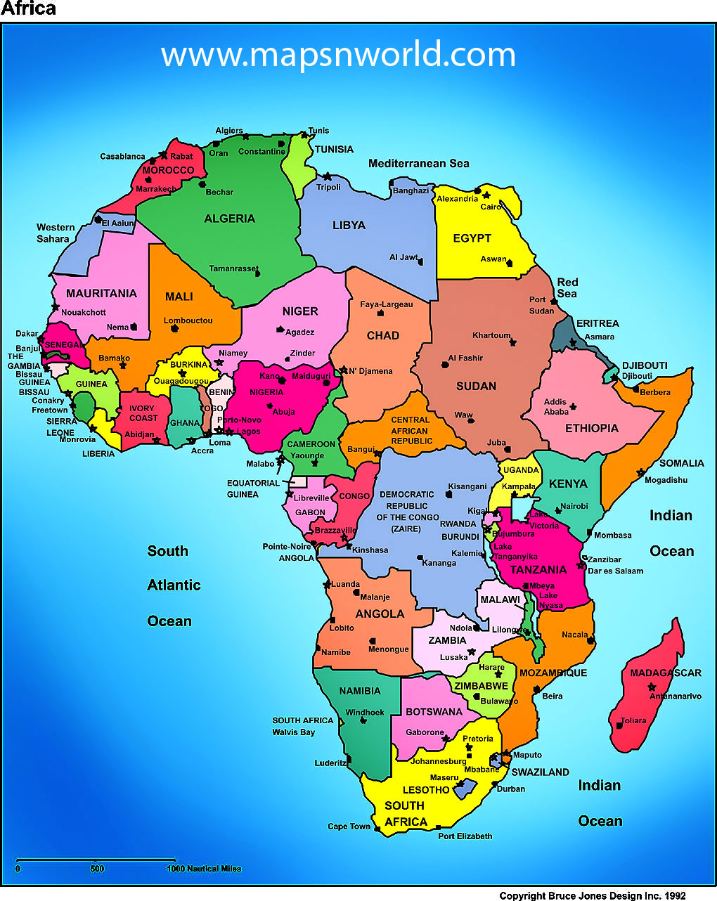
ORIGINS
THE PEOPLE
African-American Spirituals do not fit into a particular artistic period.
The singing and creation of Spirituals have been ongoing for at least four centuries in the United States.
Almost all of the first Africans who arrived to the New World were slaves.
Most of these people came from the several regions of the West Coast of Africa.

Slide 3
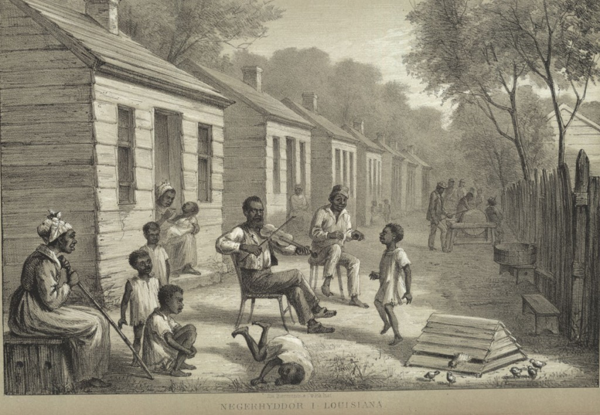
THE MUSIC
Black Spirituals are born of a culture, not of a particular time to which a year can be attached.
They sprang up in the oral tradition of an enslaved people kept illiterate by the force of law.
In the late 1700s slaves sang the precursors to spirituals called ‘corn ditties’.

Slide 4
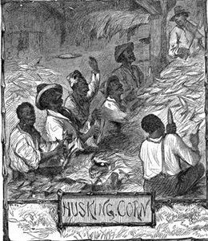
William Wells Brown (1814-1884) escaped from slavery in 1834 and became an abolitionist in the North.
He recorded this ‘corn ditty’ in his memoir My Southern Home.
All them pretty gals will be there,
Shuck that corn before you eat;
They will fix it for us rare,
Shuck that corn before you eat.
I know that supper will be big,
Shuck that corn before you eat;
I think I smell a fine roast pig,
Shuck that corn before you eat.

Slide 5
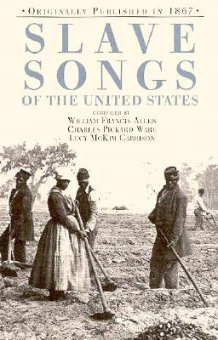
There are no known authors, composers or arrangers of the thousands of spirituals that came about during slavery.
The Spiritual’s roots can be traced back to different ethnic influences that brought about this particular style of music.
Black Spirituals obviously have an influence brought over by black slaves from Africa to America.
The Spiritual came out of the slaves’ desire for self-expression and even mental survival during a life that was heavily laden with work and many times subjugated to brutal treatment.

Slide 6
Sorrow Songs
Many spirituals were “sorrow songs.”
Sorrow Songs were Biblical expressions of grief, longing and supplication that were all too germane to the slave’s life: Sometimes I Feel Like a Motherless Child
At a time when black people were considered to be property, their Spirituals became a personal expression of freedom, an inner freedom that could not be taken away by the whip or other means. This freedom expressed was liberty of the soul.

Slide 7
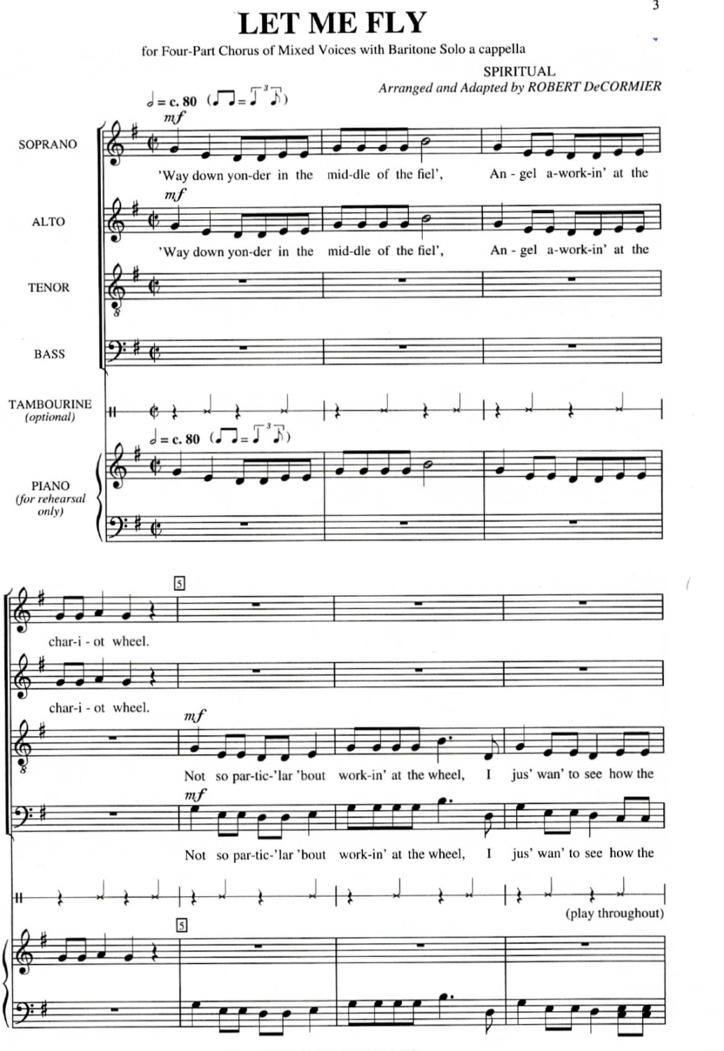
Jubilee Songs
In contrast to the Sorrow Songs were the Jubilee Songs in which clapping and vocal interjections enhanced and elevated the group‘s spirits.
Jubilee Songs celebrated the Hebrew’s release from bondage, the resurrection of Jesus and other triumphant tales from the Bible:

Slide 8
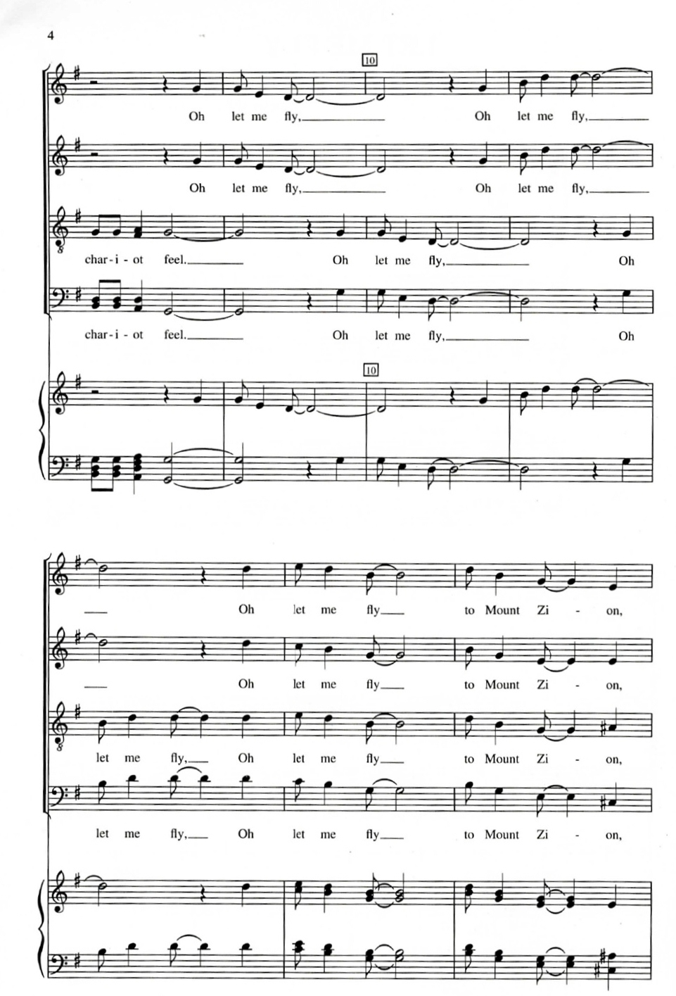
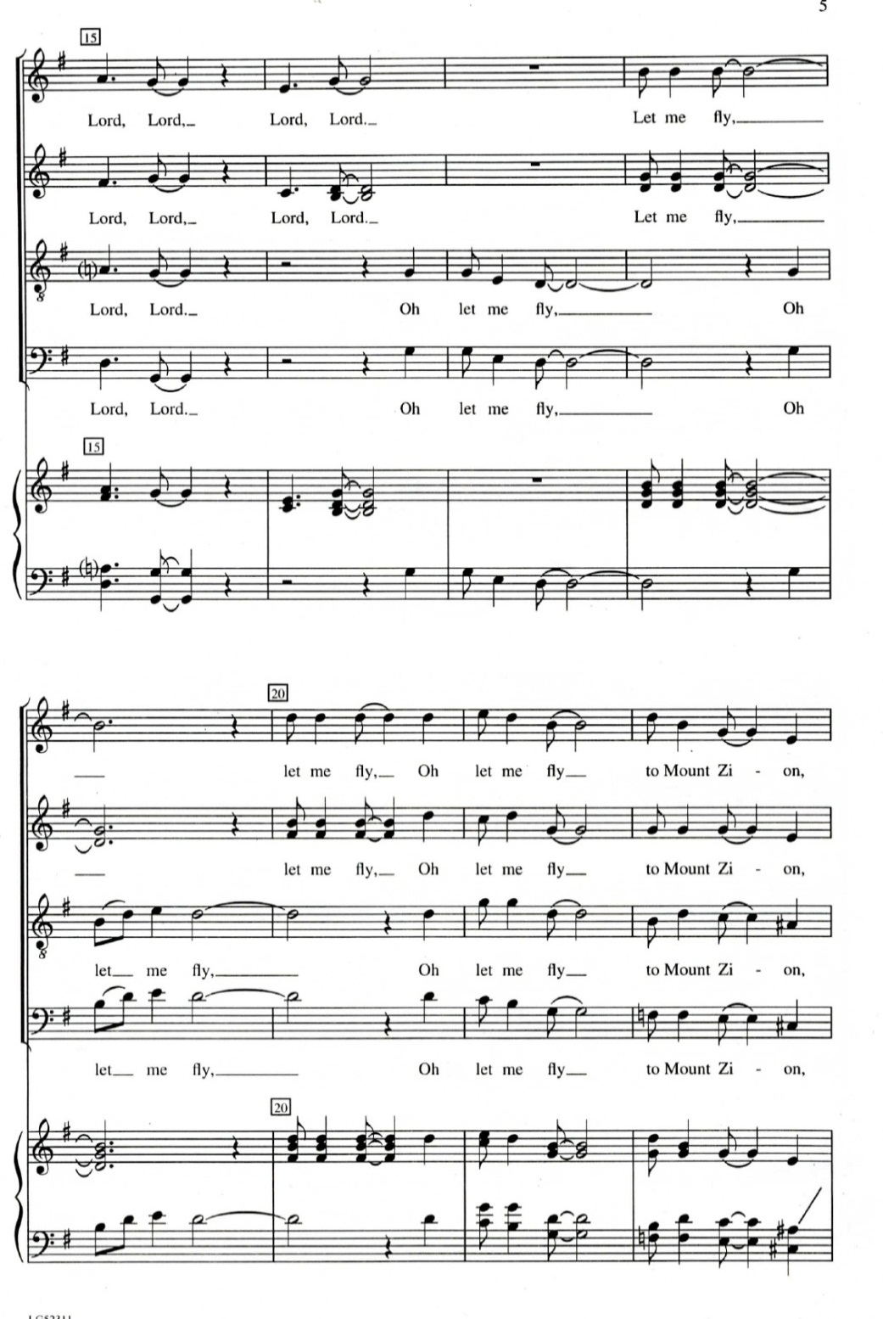

Slide 9
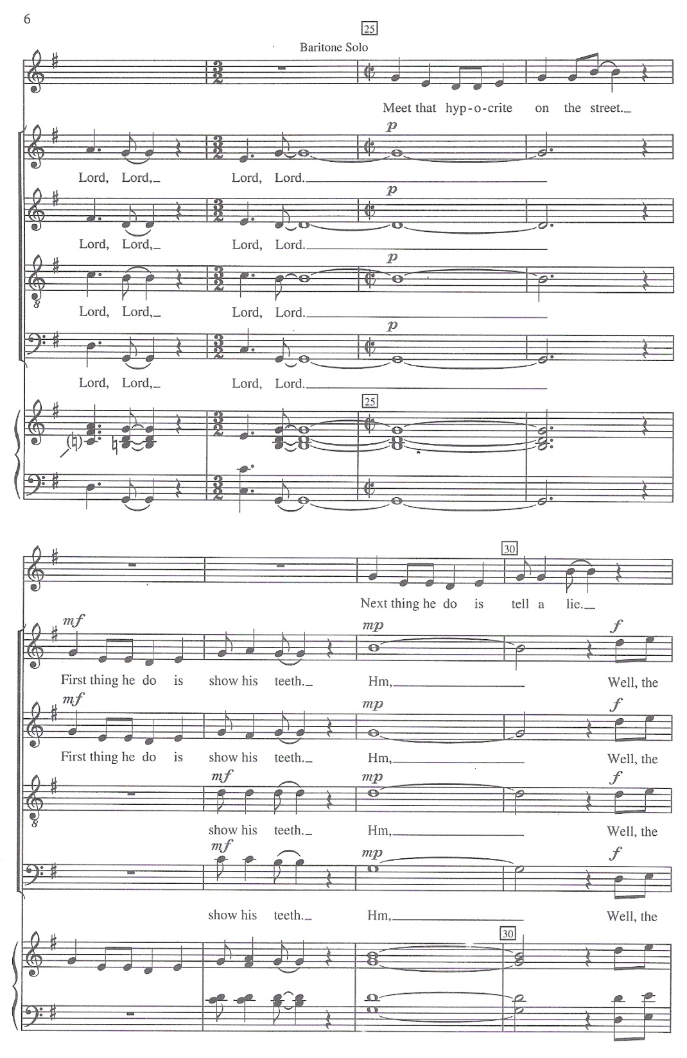
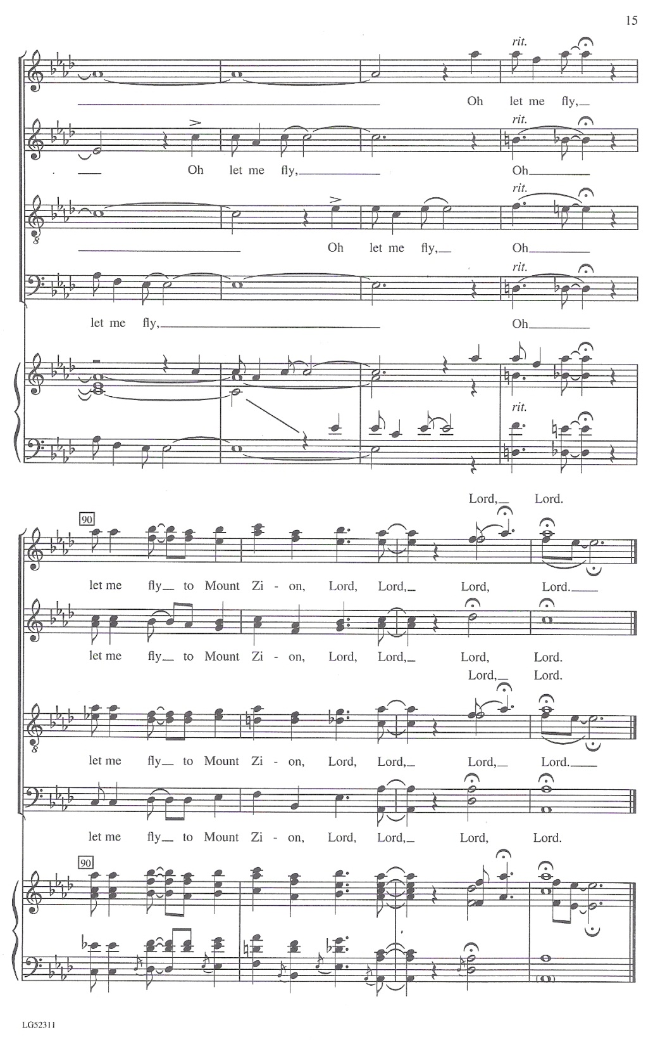

Slide 10
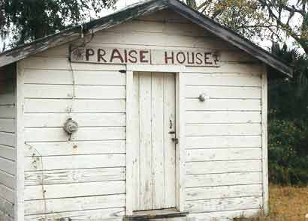
Worship services for the slaves took place in churches or in plantation ‘praise houses’ to sing and to dance.
Slaveholders did not allow their slaves to dance and to sing and sought to suppress their religious activities.
Slaveholders forbade their slaves the African custom of playing drums because the slave owners feared that the drums might be used to communicate in code a rebellion.
Slaves held meetings in secret places called ‘camp meetings’.
Slave weddings, baptisms and even funerals were part of the proceedings that took place out of the earshot of the slave owners. (Listen)

Slide 11
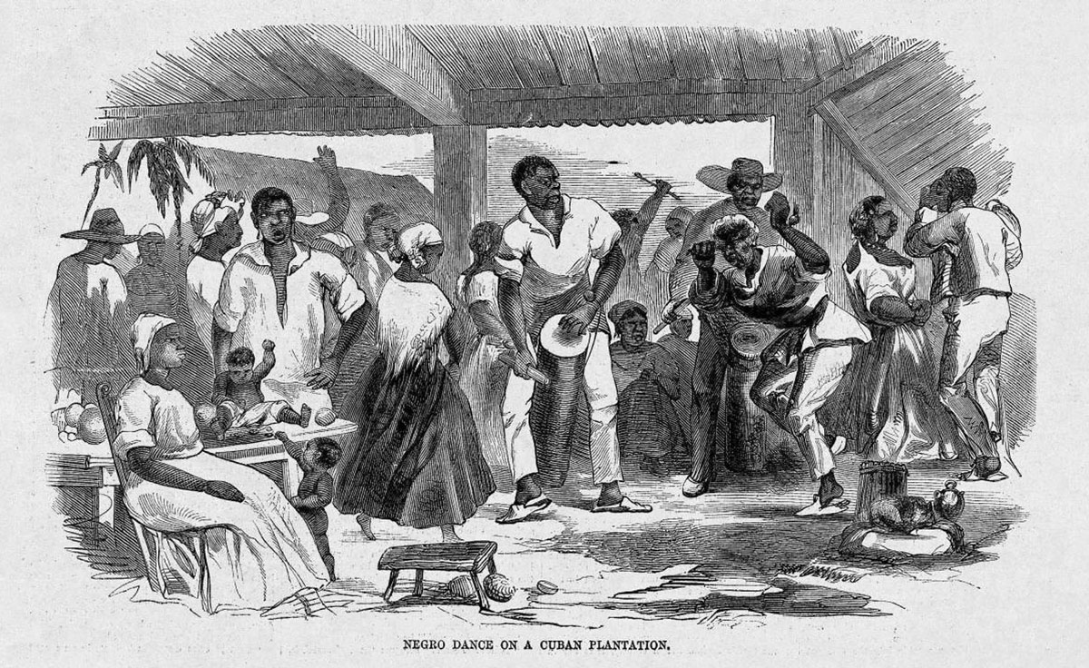
Ring Shout
Men and women arranged themselves in a ring.
The singing of a spiritual would stimulate the dancers to begin moving slowly counter-clockwise but gradually quickening the pace.
The same musical phrase was repeated over and over for hours at a time.
The dance step could be a simple shuffle of the feet or elaborate steps often with one leg raised, taking care not to cross their legs as in secular dancing.
Following the ‘formal’ Christian service the Afro-Caribbean singing and dancing of the Ring Shout ritual would take place.

Slide 12
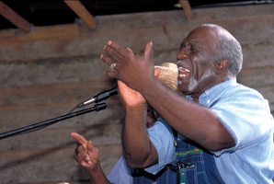
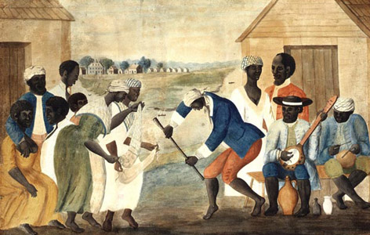
“Shouting” in black music expressed two polar affectations:
The shout encompassed the pain-filled hollers of the laborer in the fields.
The shout represented the cries of exultation that may accompany a catharsis, the release of the spirit through dance and communal participation.
Shouts are one of the principal devices that link verbal and musical inflections in African and African-American musical traditions.
The slaves used bones, wood, pattin’ Juba (dancing while slapping the hands on the hips or the thighs) and the heavy tramping of their feet to supply a hypnotic rhythm.

Slide 14
1850s
Dr. Watts’
In the city churches the Protestant City-Revival Movement led to the creation of a new song genre.
At these church services hymns and psalms were sung and were transformed into songs of a typical African-American form called ‘Dr. Watts’.
The slaves took ecstatic delight in singing Dr. Watts’ hymns.

Slide 15
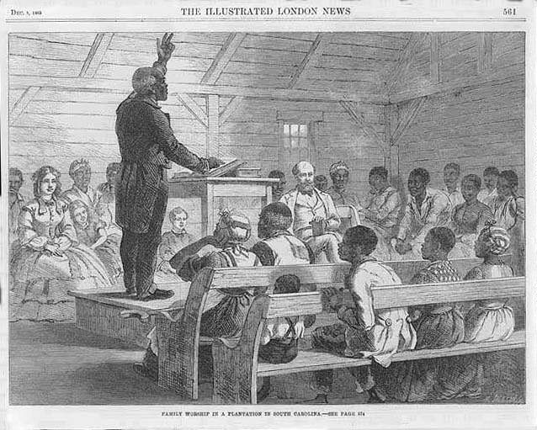
Homiletic Spiritual
Black ministers created their own style of worship music, the Homiletic Spiritual.
Here pastors borrowed from Baptist and Methodist hymnody memorable phrases and combined them with their own favorite Biblical parables and folk legends.
Slave preachers often broke into song during their sermons.
The singing preacher would repeat phrases or a particular lesson in a manner that became a call and response hymn. Scholars have termed this genre of sermons Homiletic Spirituals.
The verbal skills of the Griots (West African historians, storytellers, praise singers, poets, musicians) of West Africa can be seen in these preachers’ creative reworking of the standard hymns.

Slide 16
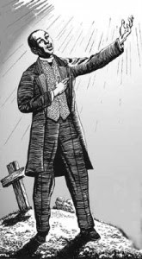
CALL & RESPONSE
Many Spirituals are set up in a call and response structure.
A soloist (‘the man of words’) calls out and the choir or congregation (the praise singers) respond or answer
Spirituals display a strong rhythmic quality as we often see in the syncopated rhythms and even, at times, polyrhythms.
This call and response structure coupled with interesting and even complex rhythmic qualities make up a unique African-derived approach to music making.

Slide 17
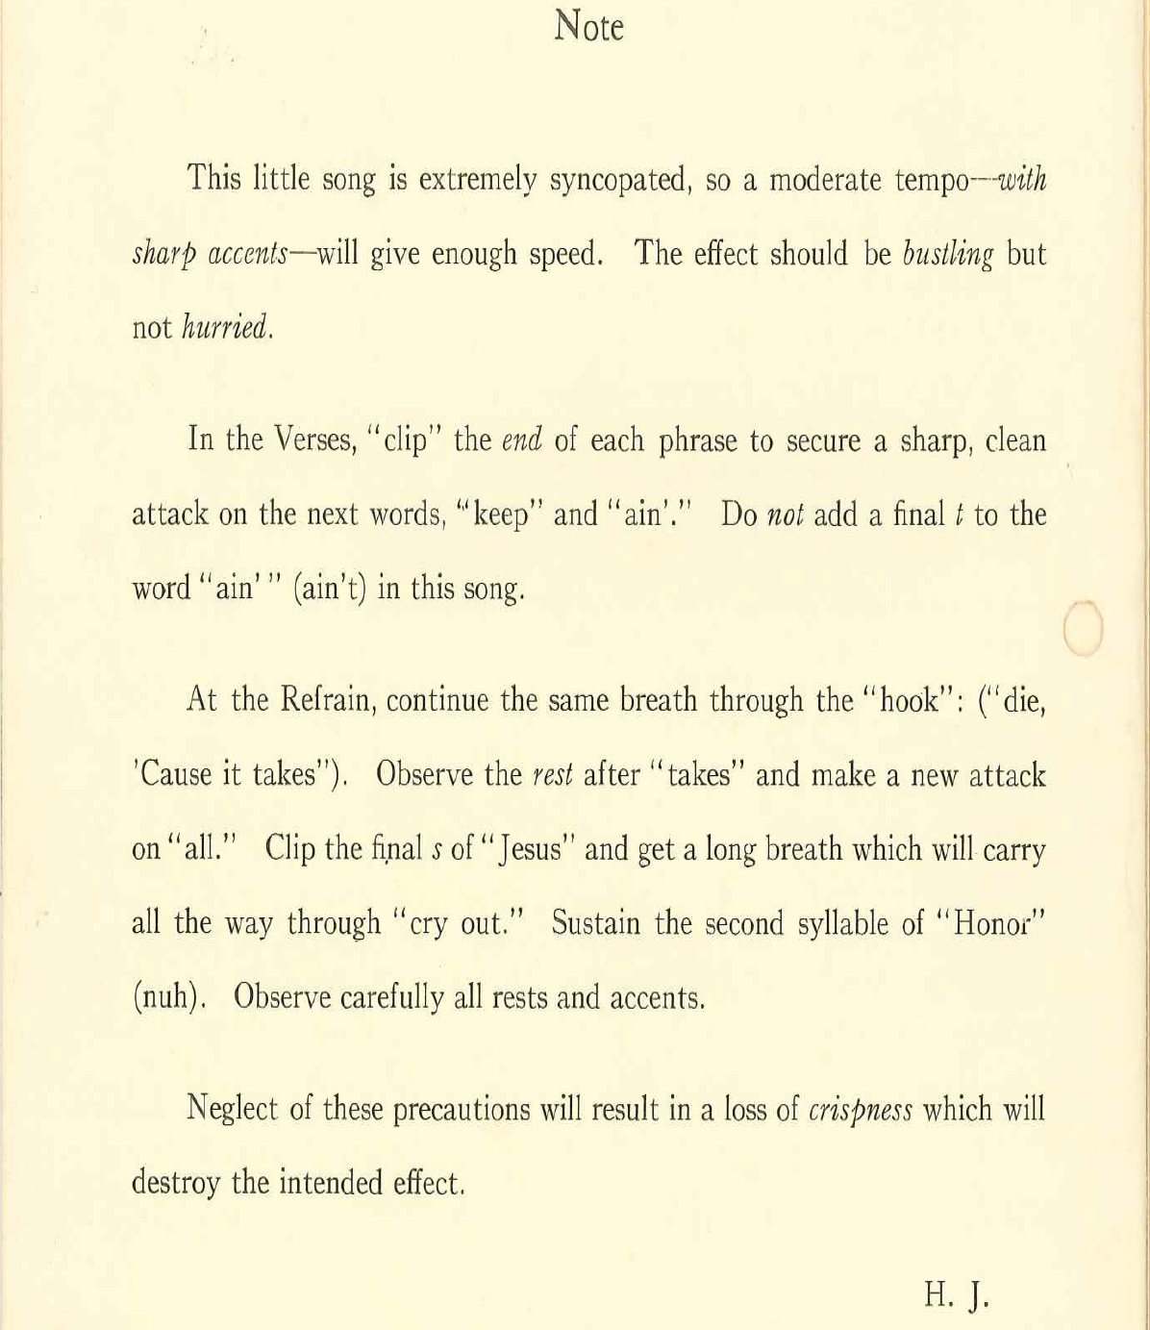

Slide 18
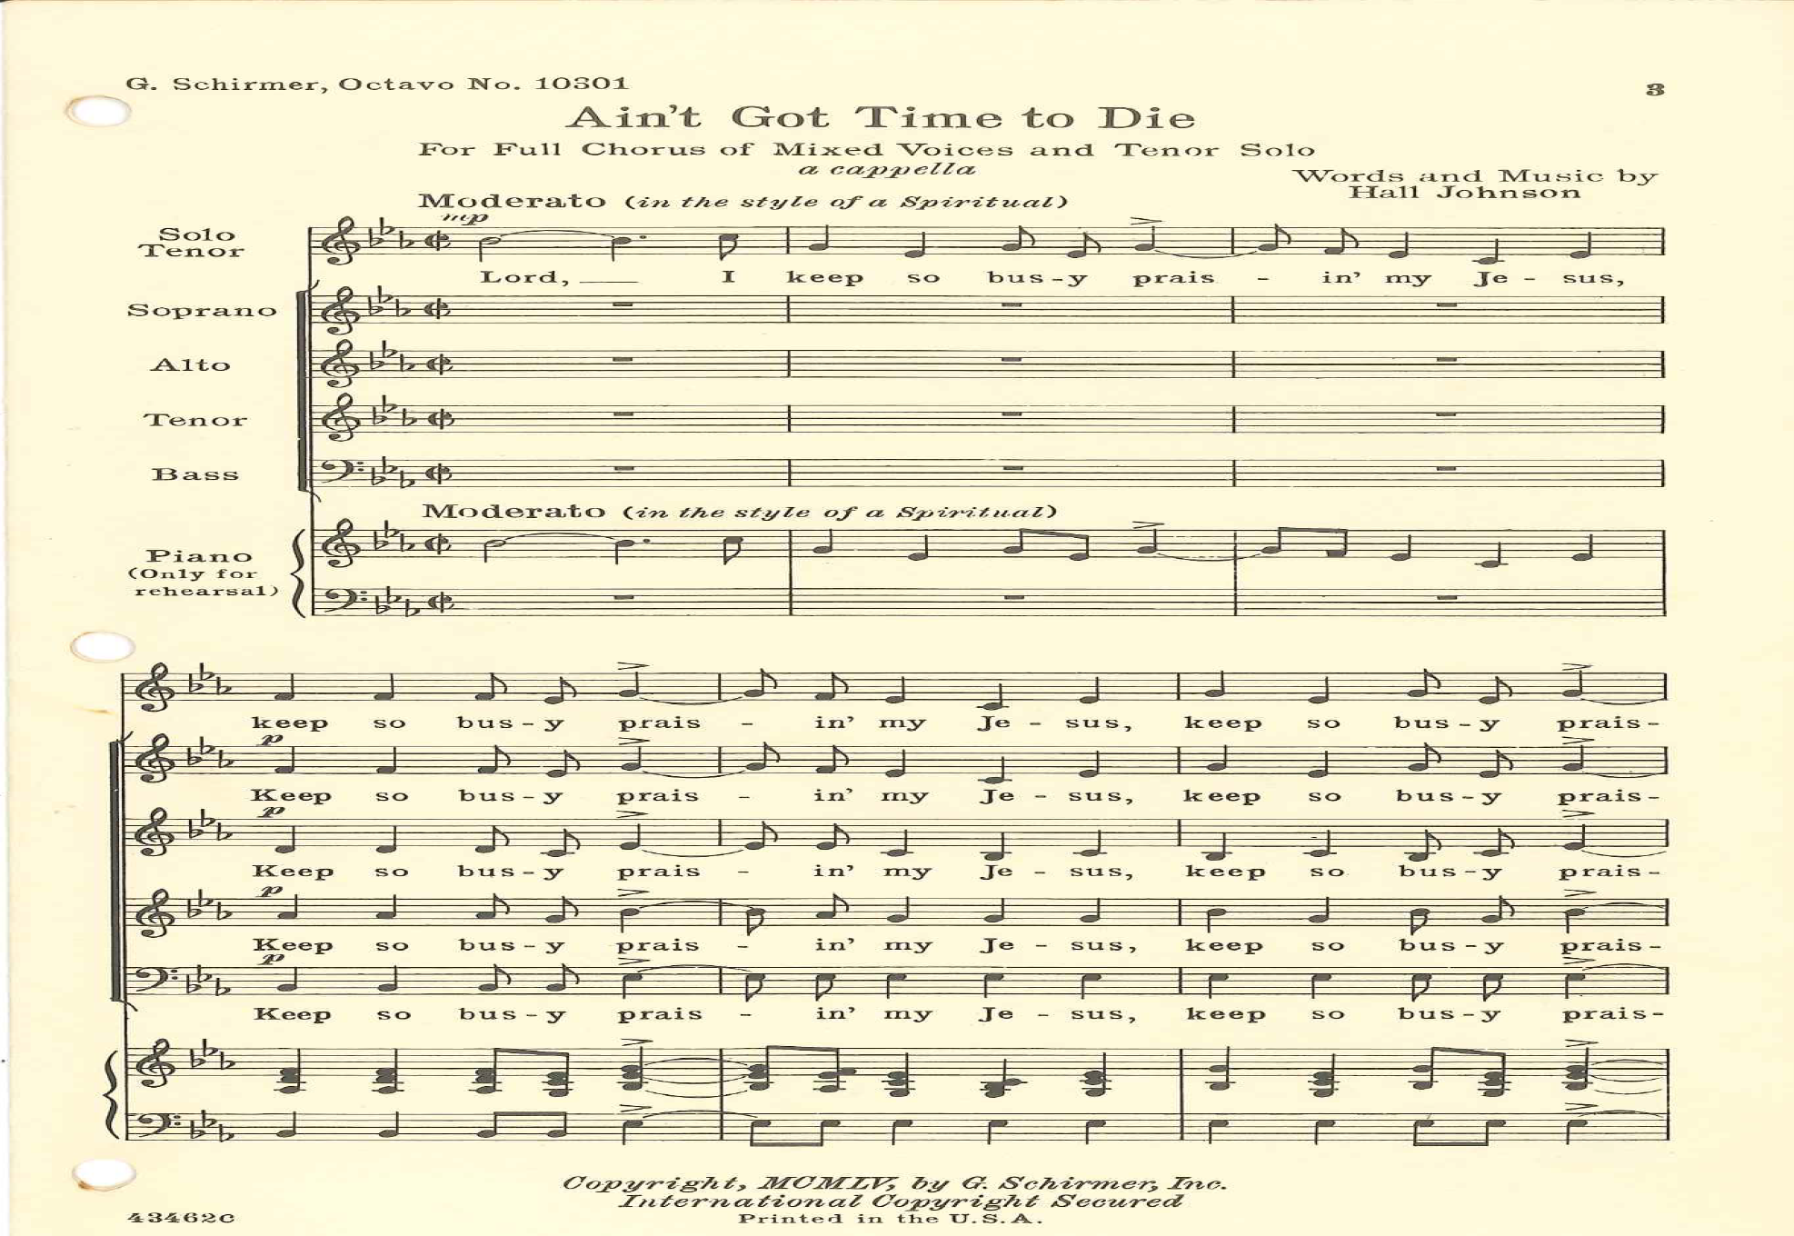
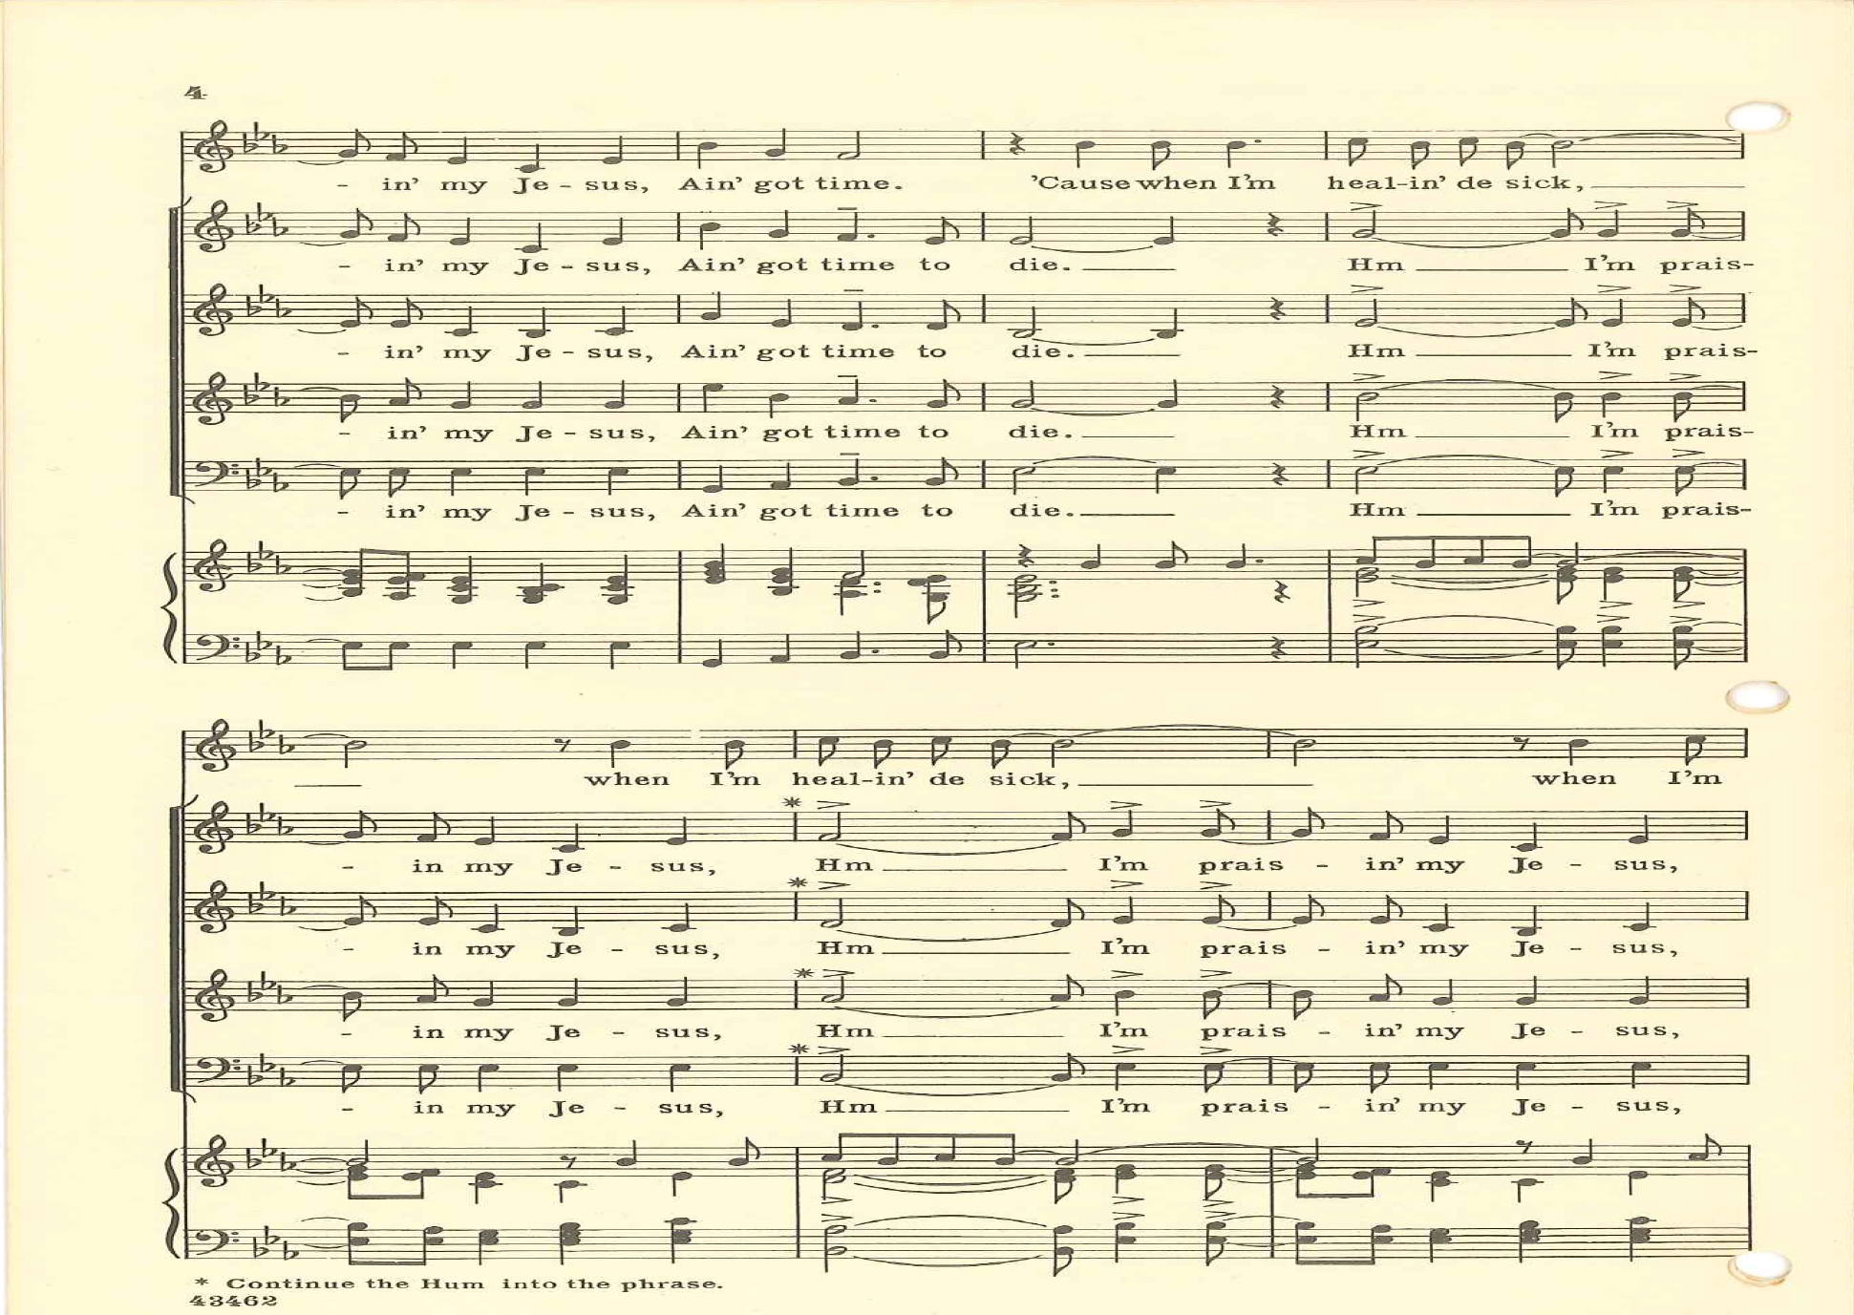
(Listen) http://www.youtube.com/watch?v=kgM1Df76S5c&feature=kp

Slide 19
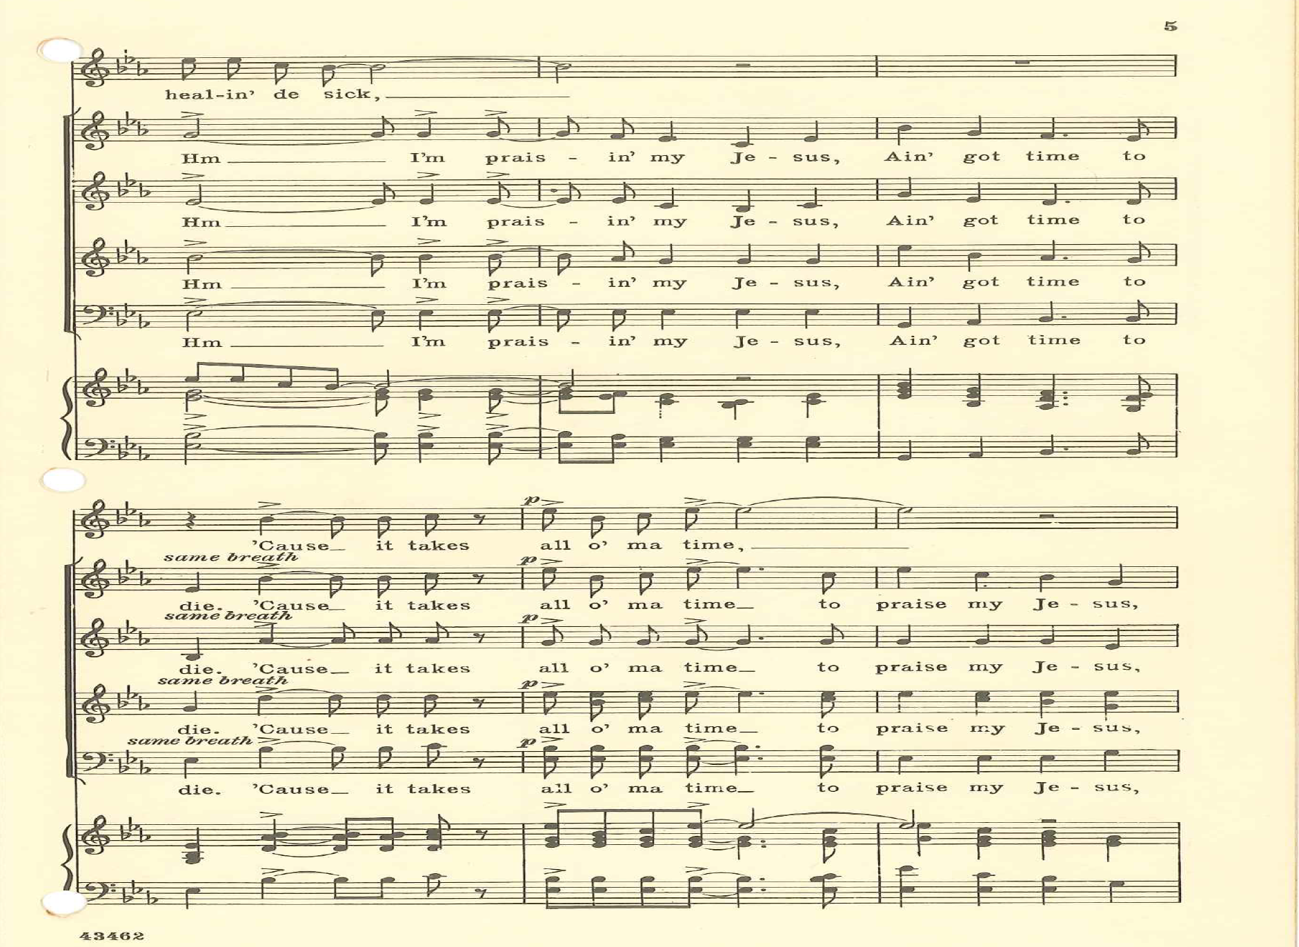
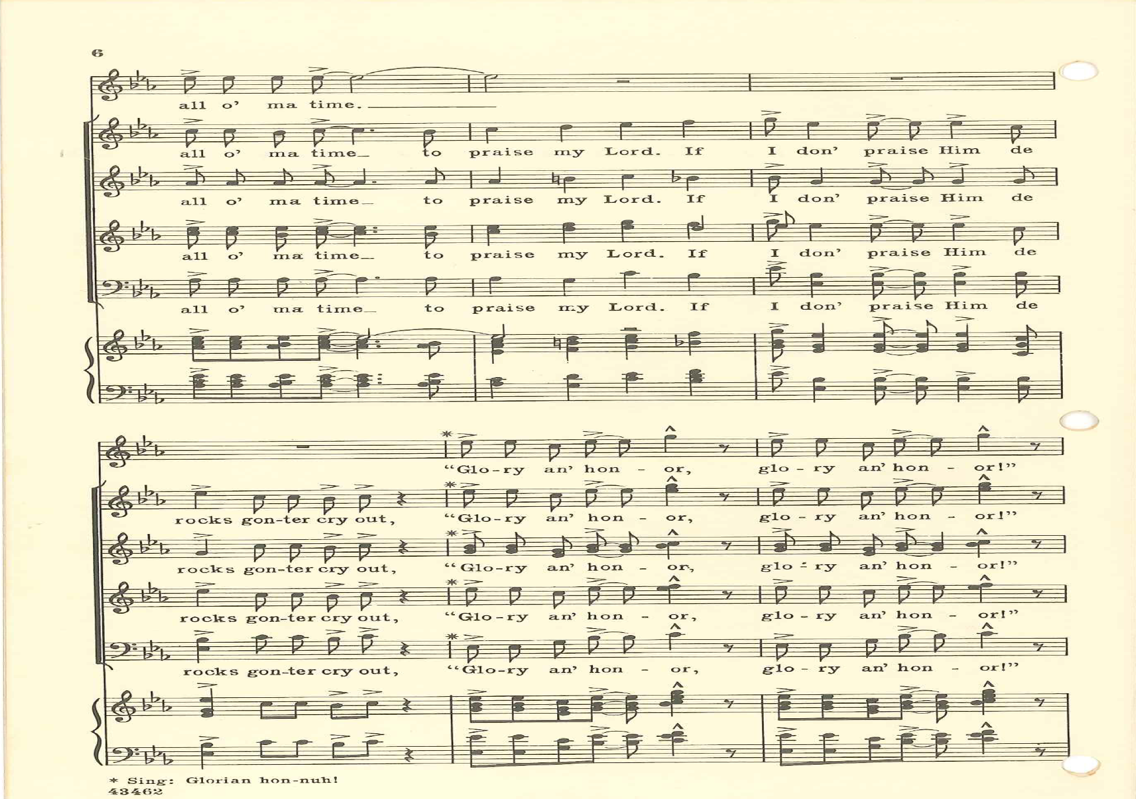

Slide 20
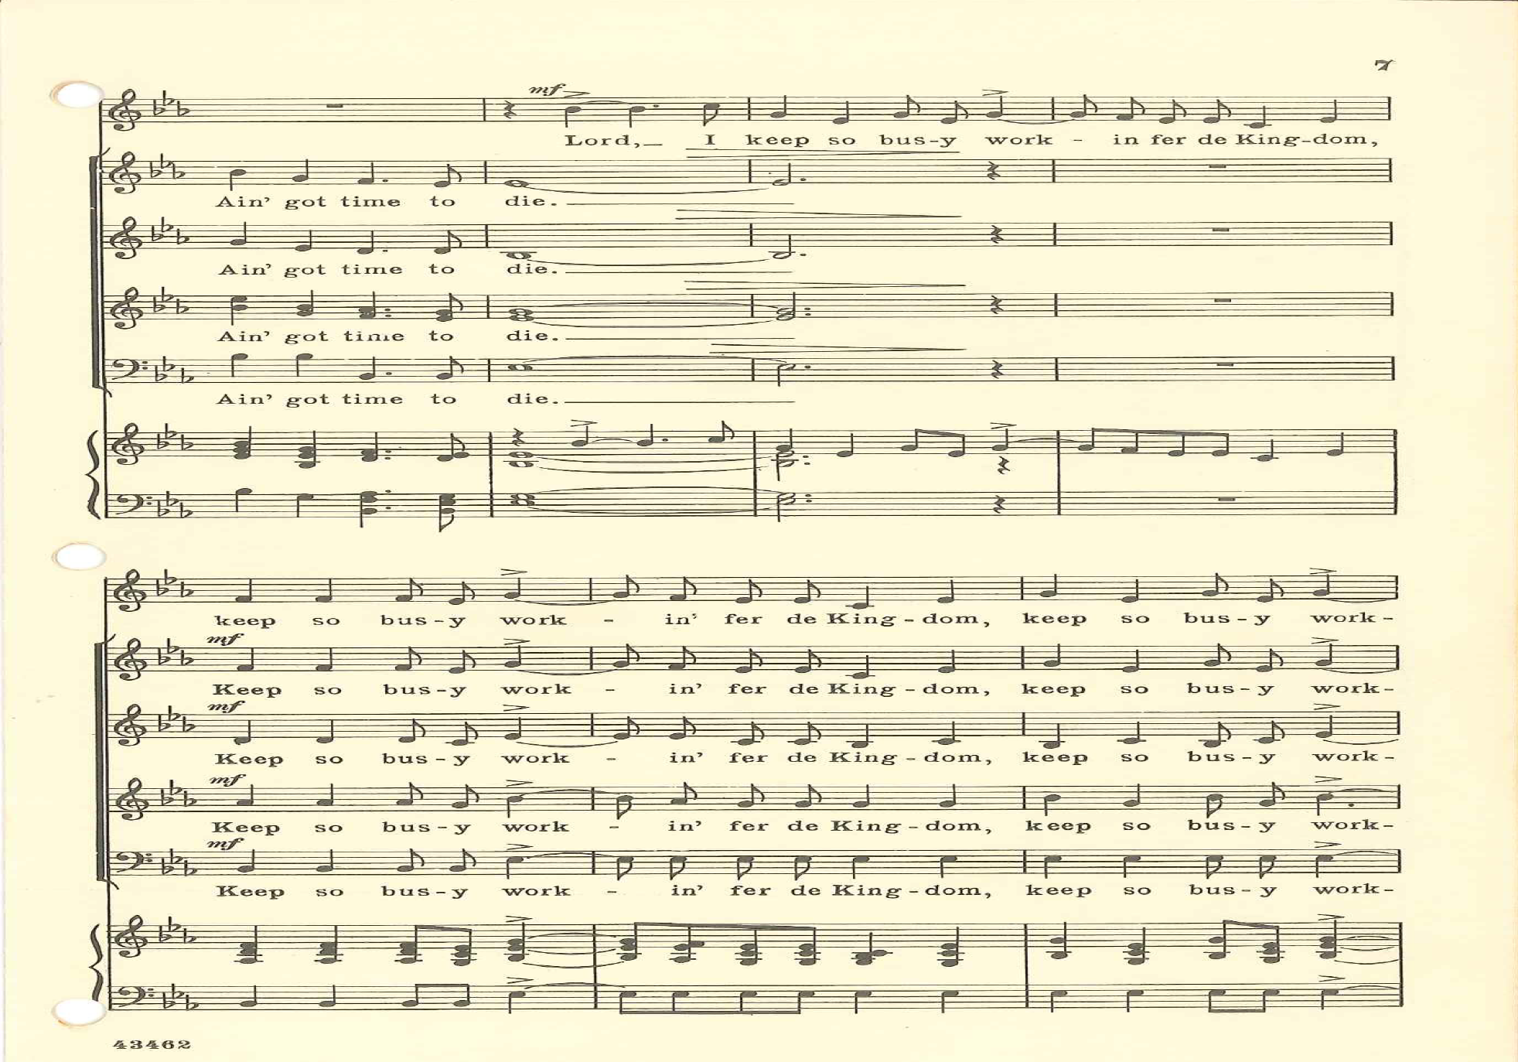

Slide 21
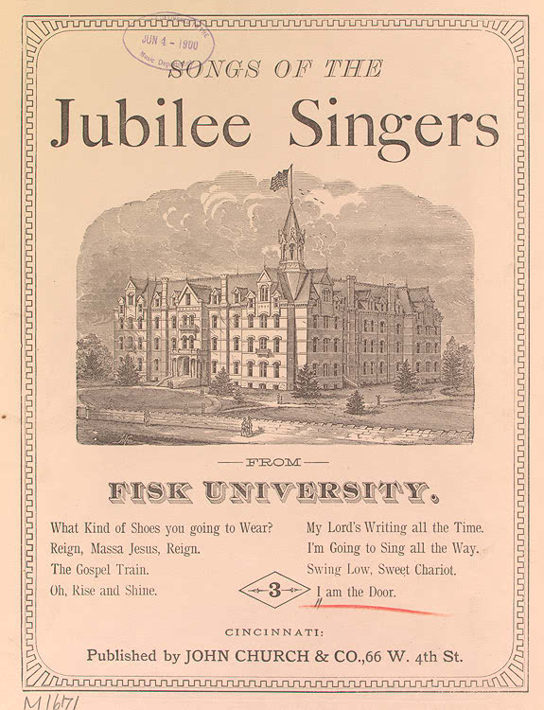
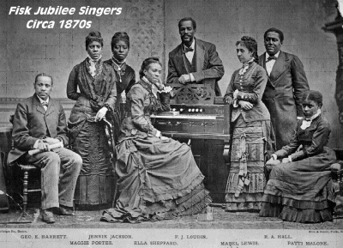
AFTER 1865
Slavery was abolished in 1865.
African-Americans were permitted to attend school and be graduated.
Institutions of higher learning were established for African-Americans.
Fisk University, Nashville, Tennessee. Tuskegee Institute was another.
Their choirs made concert tours to Europe and the spiritual became an international hit.
Jubilee Songs was published in 1872 by Fisk University for the Fisk University Jubilee Singers and is one of the first printings of slave songs in the United States.
Black churches were heirs to the plantation ‘praise house’ shouts, hand clapping, foot stomping and jubilees songs.
Black composers began to create new arrangements of Negro Spirituals that took on some of the character of European classical music.

Slide 22
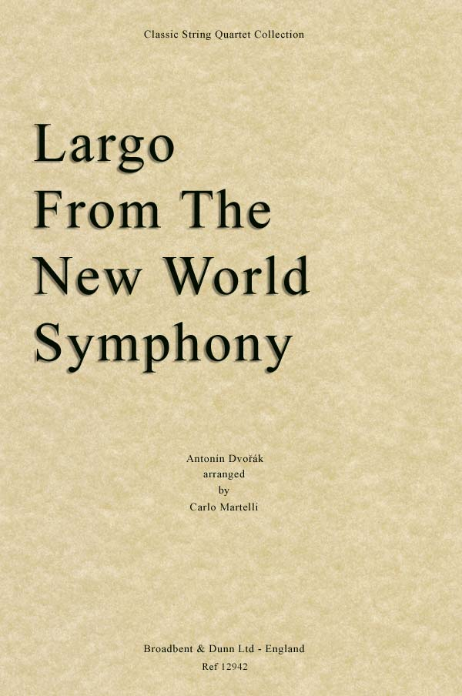
Anton Dvořák
Czech composer
Director of the New York Conservatory
Symphony No. 9 in E Minor From the New World in 1893.
Dvorak brought attention to the genre of Spirituals as his Second Movement – Largo is a setting of the spiritual Goin’ Home, or so it was thought.
(Listen)
http://www.youtube.com/watch?v=M9smSP1dq-A

Slide 23
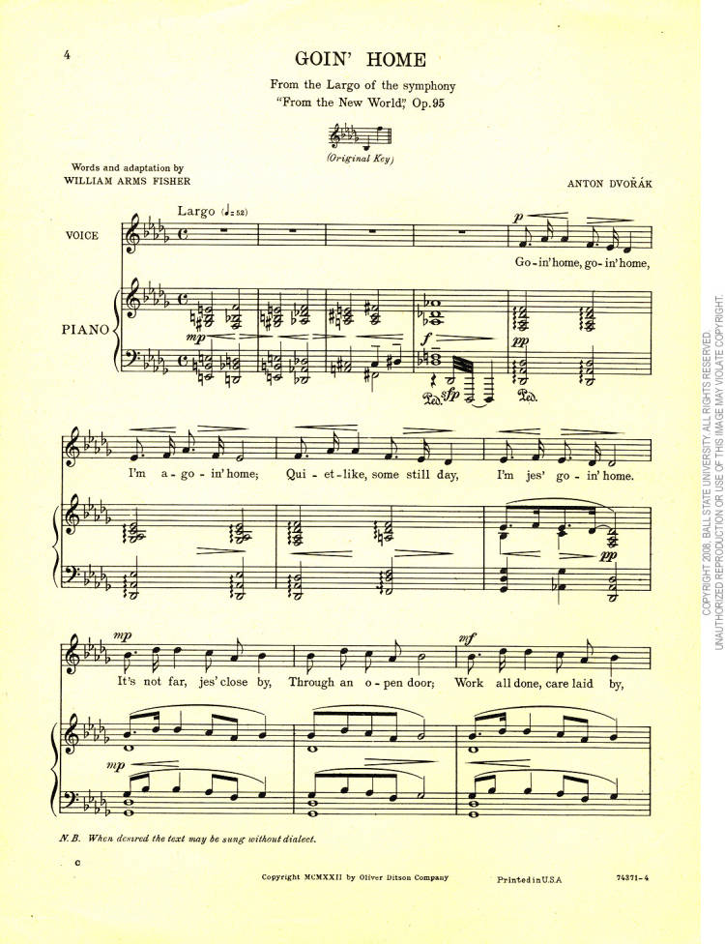
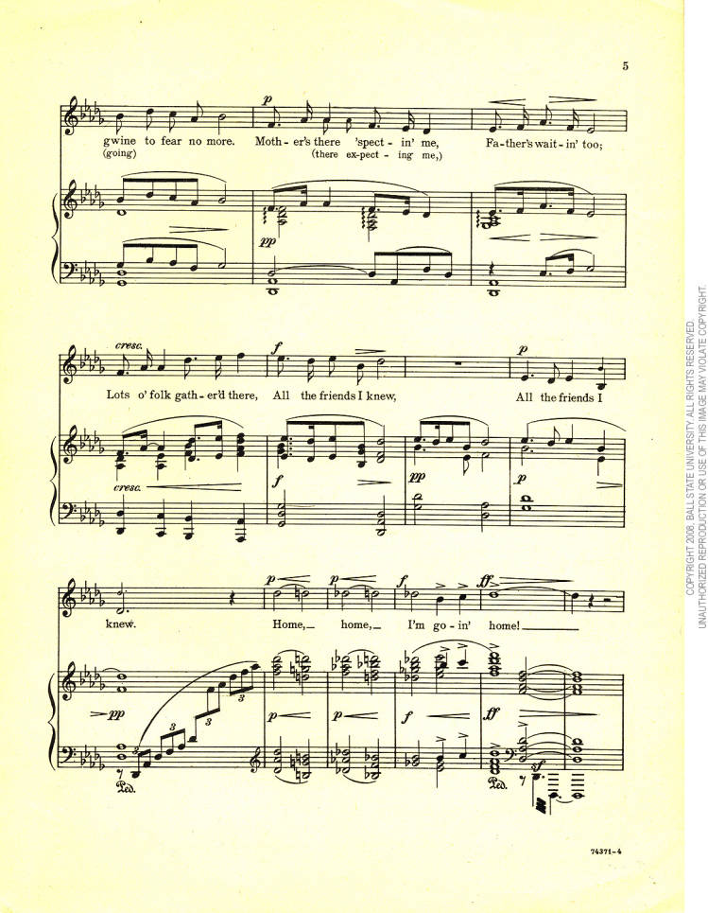

Slide 24
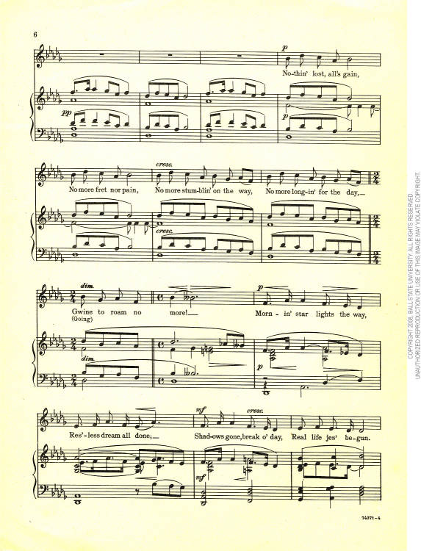
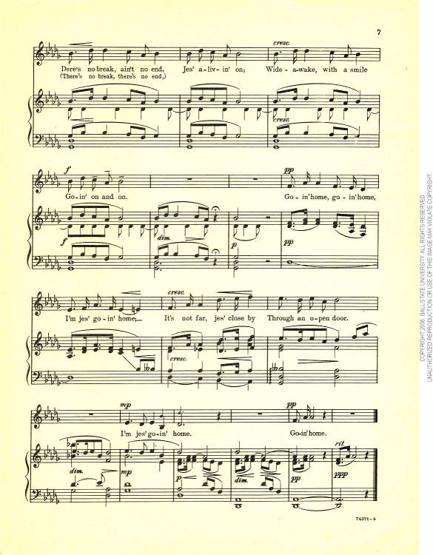

Slide 25
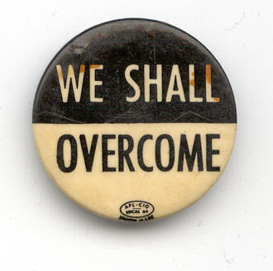
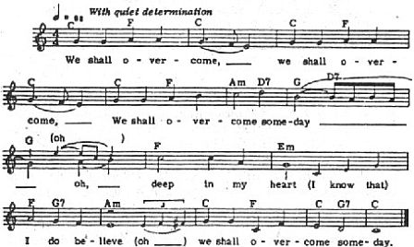
Charles Albert Tindley (1851-1933)
Son of slaves, he taught himself to read at the age of seventeen.
He worked a janitor and attended night school and earned a Master of Divinity degree.
In 1902 Tindely became the pastor of the Calvary Methodist Episcopal Church in Philadelphia, the same church where he had worked as a janitor.
His I’ll Overcome Some Day was the cornel for the American civil rights anthem We Shall Overcome, popularized in the 1960’s in the freedom movement inspired by Dr. Martin Luther King.

Slide 26
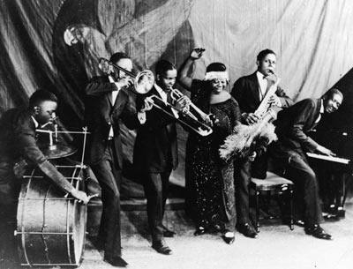
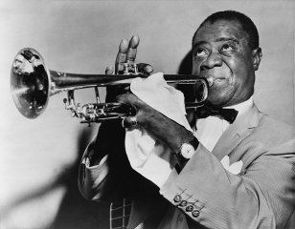
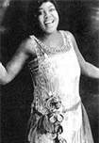
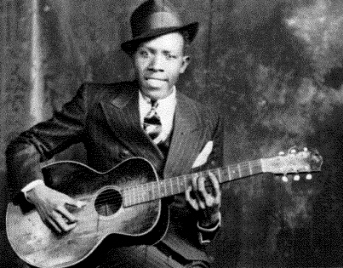
1920s
Black Renaissance in poetry and music infused with a new race-spirit.
African-Americans acknowledged that their roots were deep in the land of their birth, America.
Strong influence on the singing and interpreting Negro Spirituals.
Historical meaning of these songs was put forward.
Singers were pushed to become better skilled.

Slide 27
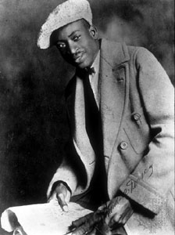
Gospel Song
Improvement of Negro Spirituals gave birth to another form of Christian song.
These songs were inspired by Biblical (mainly Gospel) themes related to events in daily life.
Thomas A. Dorsey (1899-1993) known as ‘the father of black gospel music’.
The Gospel Song combines Christian praise with the rhythms of jazz and the blues.
In 1932 Mr. Dorsey wrote his classic and most famous song Precious Lord as result of suffering grief over the loss of his first wife in childbirth.
Almost equally well known is his Peace in the Valley that he wrote for Mahalia Jackson in 1937.

Slide 28
Sister Rosetta Tharpe (1915-1973)
Singer, songwriter and recording artist, Sister Rosetta Tharpe, was a one-of-a-kind 20th Century music pioneer.
In the 1930’s and 1940’s with her gospel recordings were a unique mixture of spiritual lyrics and early rock ‘n’ roll accompaniment.
She took sacred music into secular nightclubs using big bands for her backup.
As the first recording artist to impact the music charts with her spiritual recordings, she was the first superstar of gospel music … ‘the original soul sister’.
(Listen)

Slide 29
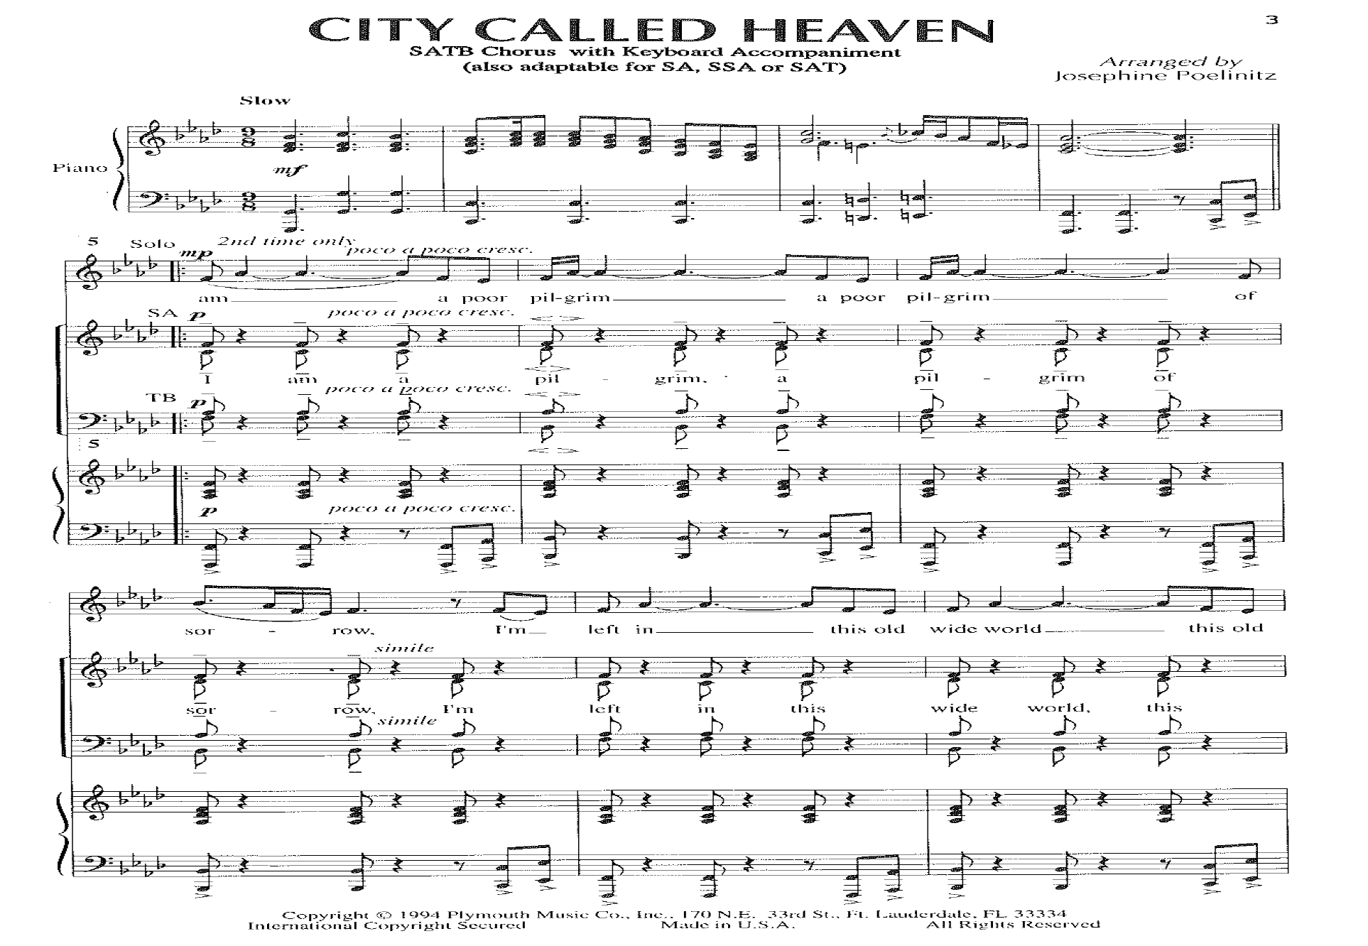
GOSPEL
Gospel music is another great contribution to the choral art by African-American musicians.
Gospel music, said to be a celebration and an affirmation of life, has grown in popularity in recent years among the choral community as a whole.
African-Americans formed their own congregations and Gospel songs became the most important part of their services.
The prevalence of Gospel music in African-American churches can still be seen today and it has become for this people a means to identify with their cultural and historical past.

Slide 30
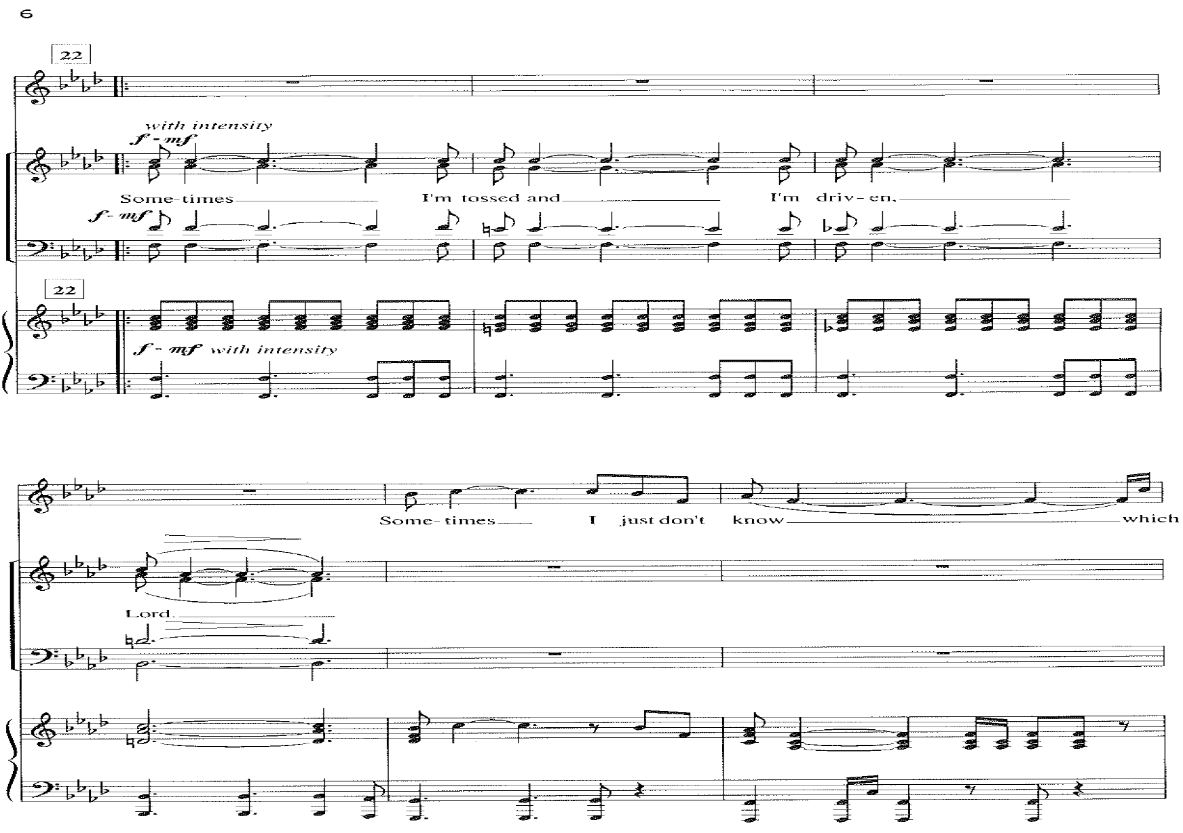
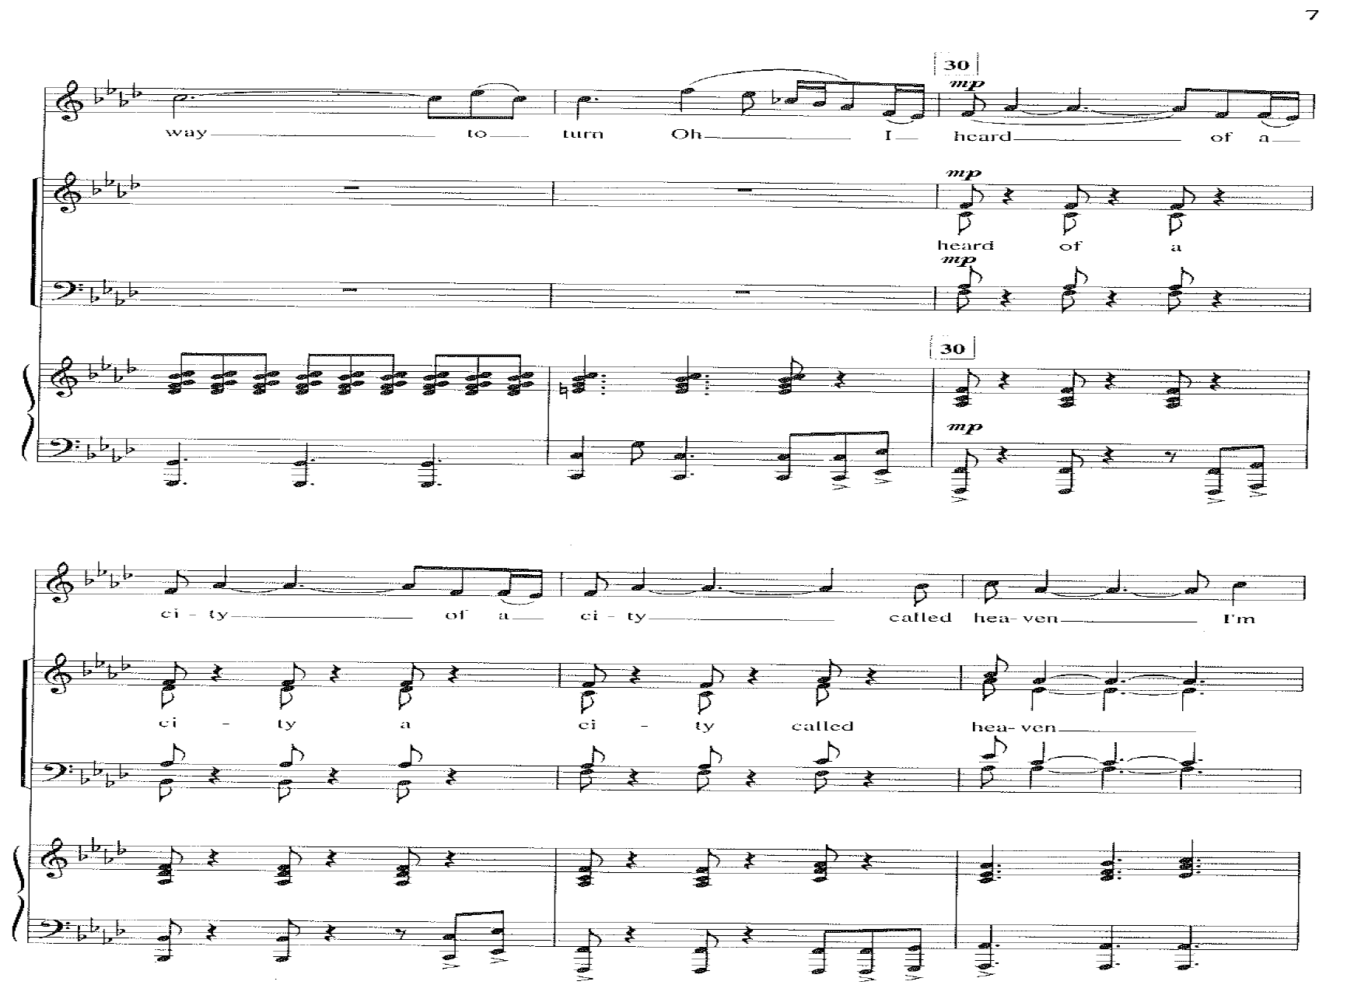

Slide 31
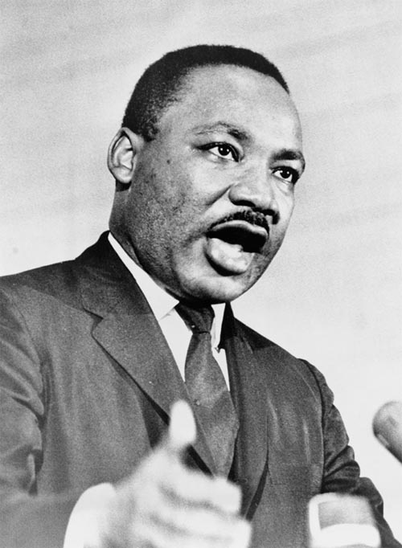
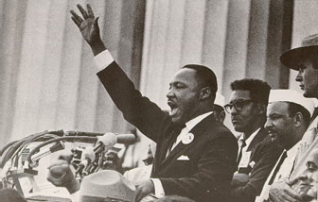
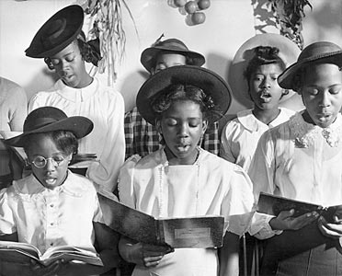
MARTIN LUTHER KING’S DAY
First celebrated in 1985 and was set apart as a national holiday in 1992.
Since that first Martin Luther King’s Day African-American Spirituals have increasingly become important pieces in the musical fabric of our American heritage.
Today, choirs of all ilk and all types of people perform Spirituals and Gospel Songs all over the world.

Slide 32
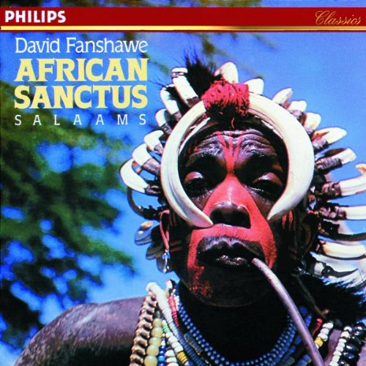
SUMMARY
In lectures to my choral conducting students on concert programming, I say that it is always appropriate to end the concert with the ‘obligatory’ Spiritual. They are always a hit.

Slide 33
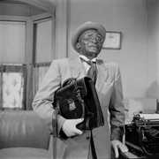
Jester Hairston
Arranger/composer, traveling choir leader, actor and story teller, Jester Hairston’s career took him all over the world. Perhaps he is best remembered for his role as Rolly Forbes on the TV show Amen. He was born the grandson of slaves in 1901 Belews Creek, North Carolina.
He was a star athlete in high school and college. R. Hairston graduate Cum Laude from Tufts University with a major in music and the furthered his studies at Julliard School of Music in New York City.
In 1936 Mr. Hairston went to Hollywood with another famous African-American spiritual writer/arranger, Hall Johnson, to help with the arranging of chorus music for the film Green Pastures. In 1947 he became a founding member of the Screen Actors Guild. In 1943 he formed his own choir and arranged choral background music for many of Hollywood’s important films, among them was Carmen Jones. As an actor he played on the Amos and Andy Show for fifteen years. He played ‘Wildcat’ on the 1970’s TV show That’s My Mama.
I was pleased to work with Jester Hairston on many occasions and was privileged to be with the Los Angeles Spiritual Singers as he led this first black choir into the old Communist Eastern Block countries on a concert tour. He departed this earth at 99 years of age and was an ambassador of the African-American Spiritual to the world.

Slide 34
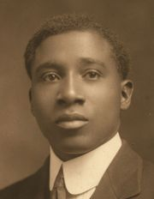
R. Nathaniel Dett
Robert Nathaniel Dett (1882-1943) was the grandson of a slave who became the first black student to complete a Bachelor of Music degree in at Oberlin Conservatory of Music. He toured as a concert pianist and became a professor at Lane College in Tennessee followed by stint at the Lincoln Institute in Missouri. Professor Dett became the first black director of the Hampton Institute in Virginia. In 1918 Professor Dett wrote this of his compositional goals.
We have this wonderful store of folk music - - the melodies of and enslaved people . . . But this store will be of no value unless we utilize it, unless we treat it in such a manner that it can be presented in choral form , in lyric and in operatic works, in concertos and suites and salon music – unless our musical architects take the rough timbre of Negro themes and fashion from it music which will prove that we, too, have nationals feelings and characteristics, as have the European peoples whose forms we have zealously followed for so long. (Arkivmusic.com)

Slide 35
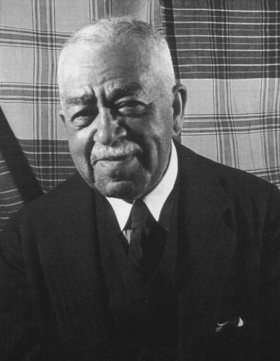
Henry ‘Harry’ Thacker Burleigh
Harry Burleigh (1866-1949) was a gifted professional singer, a Baritone. He was the first black composer to be instrumental in the development of a characteristically American from of music, black music. Burleigh made spirituals and other black forms available to the classically trained musicians by arranging black music into more classically based forms.
Burleigh attended the National Conservatory of Music, now the Julliard School, and played double bass in the orchestra. He was an assistant to Anton Dvorak where he spent most of his time doing copy work, transferring the manuscript of Dvorak’s Symphony No. 9 into the various instrumental parts. Deep River is his most famous Spiritual and remains a favorite of choirs all over the country.

Slide 36
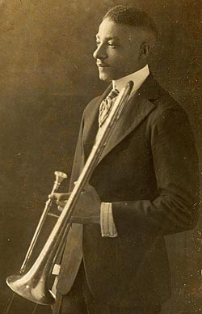
William Levi Dawson
William Dawson (1899-1990) was a most important African-American composer, choral director and professor. He earned a Bachelor of Music degree from the Horner Institute of Fine Arts and a Master of Music from the American Conservatory of Music in Chicago. From 1931 to 1956 William Dawson held a professorship at t he Tuskegee Institute where he developed the Tuskegee Institute Choir into an internationally renowned ensemble. In 1932 the Choir presented a week of six daily concerts of Spirituals at New York City’s Radio City Music Hall.
The Philadelphia Orchestra under the direction of Leopold Stokowski premiered his Negro Folk Symphony in 1934. In 1952 Dawson made a trip to West Africa. After this pilgrimage, Dawson attempted to convey in his music some of the African rhythms and other missing elements that were lost when Africans lost their homeland and fell into bondage in a foreign place. Dawson’s arrangements of African-American Spirituals are widely published in the United States and are part of the standard repertoire by public school, college and community choral programs. Ain-a That Good News, Ezekiel Saw the Wheel, Jesus Walked that Lonesome Valley, King Jesus Is a-Listening and I’ve Been Buked are among his most popular works.

Slide 37
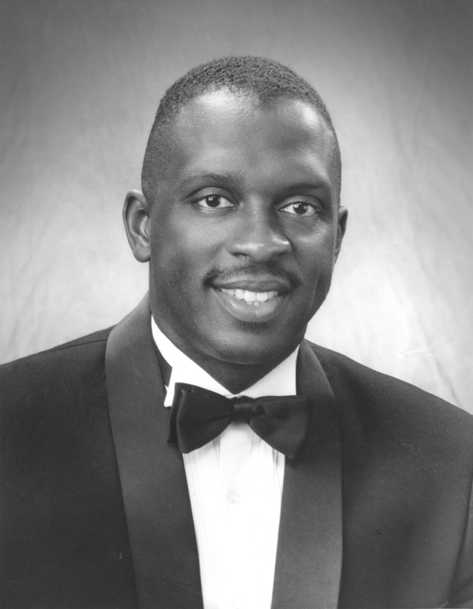
Moses Hogan
Moses George Hogan (1957-2002) was a pianist, conductor and arranger of international renown. He studied at the Oberlin Conservatory and the Julliard School of Music. Mr. Hogan began to explore the world choral music and the African-American Spiritual idiom especially. Hogan’s New Orleans based Moses Hogan Chorale received international acclaim performing his inventive contemporary style of spiritual writing.
Hogan was commissioned to arrange and perform several compositions for the 1995 PBS Documentary, The American Promise. He served as the editor of the Oxford Book of Spirituals, Oxford University Press. His 70 published spiritual arrangements and original compositions are published by Hal Leonard and are staples of the repertoire for high school, college, church, community and professional choirs worldwide.

Slide 38
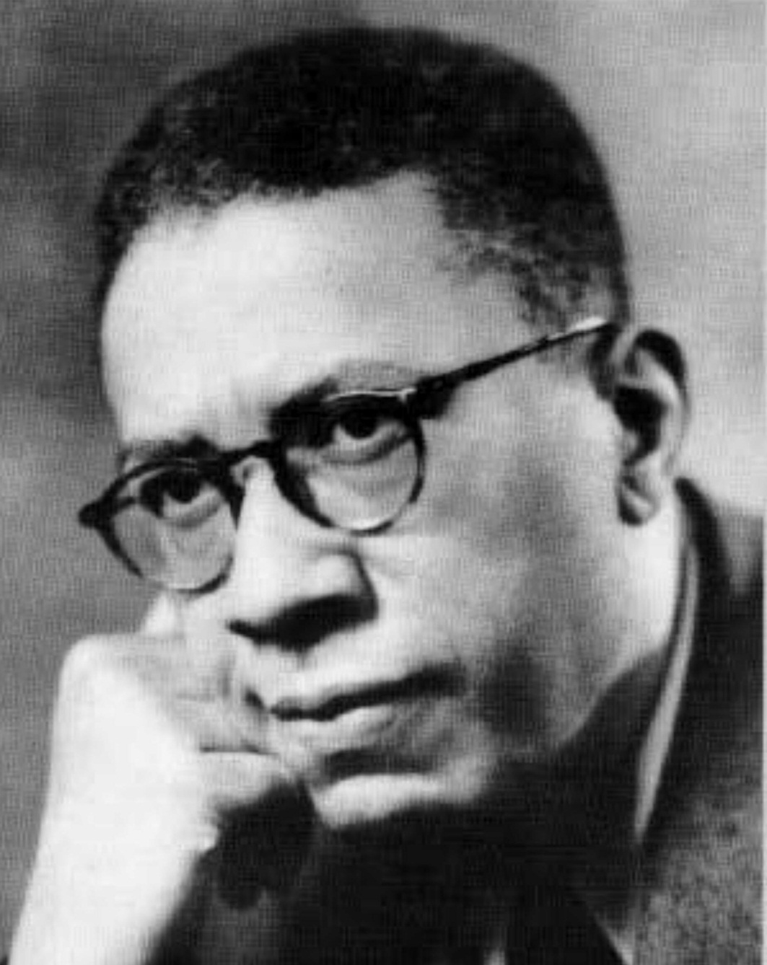
Hall Johnson

