Slide 1
Funding opportunities

Slide 2
University of Florida financial aid resources
Grants and scholarships are often called “gift aid” because they are free money—financial aid that doesn’t have to be repaid. Grants are often need-based, while scholarships are usually merit-based.
Money awarded to students based on academic or other achievements to help pay for education expenses. Scholarships generally do not have to be repaid.

Slide 3
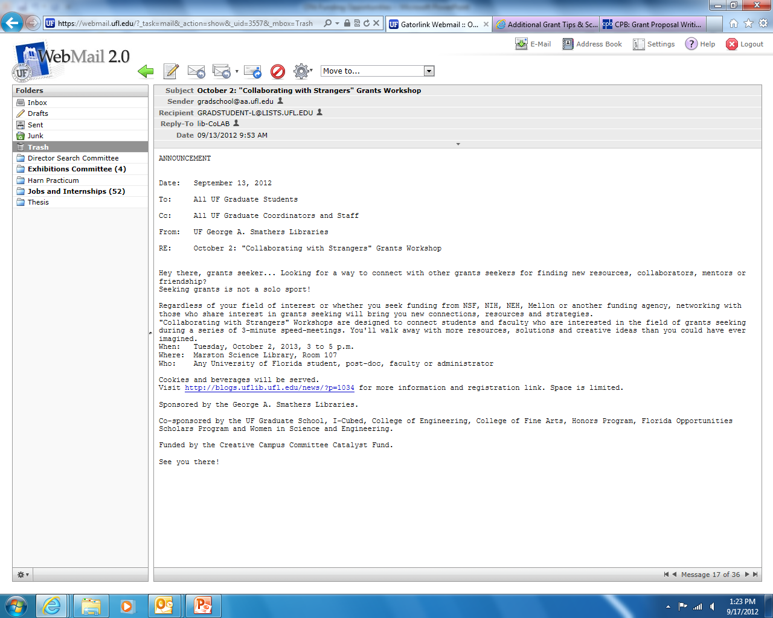
have you checked your e-mail?
Subject October 2: “Collaborating with Strangers” Grants Workshop
Sender gradschool@aa.ufl.edu
Recipient GRADSTUDENT-L@LISTS.UFL.EDU
Reply-To lib-CoLAB
Date 09/13/2013
ANNOUNCEMENT
Date: September 13, 2012
To: All UF Graduate Students
Cc: All UF Graduate Coordinators and Staff
From: UF George A. Smathers Libraries
RE: October 2: “Collaborating with Strangers” Grants Workshop
Hey there, grants seeker…Looking for a way to connect with other grants seekers for finding new resources, collaborators, mentors or friendship? Seeking grants is not a solo sport!
Regardless of your field of interest or whether you seek funding from NSF, NIH, NEH, Mellon or another funding agency, networking with those who share interest in grants seeking will bring you new connections, resources and strategies. “Collaborating with Strangers” Workshops are designed to connect students and faculty who are interested in the field of grants seeking during a series of 3-minute speed-meetings. You’ll walk away with more resources, solutions and creative ideas than you could have ever imagined.
When: Tuesday, October 2, 2013, 3 to 5 p.m.
Where: Marston Science Library, Room 117
Who: Any University of Florida student, post-doc, faculty or administrator

Slide 4
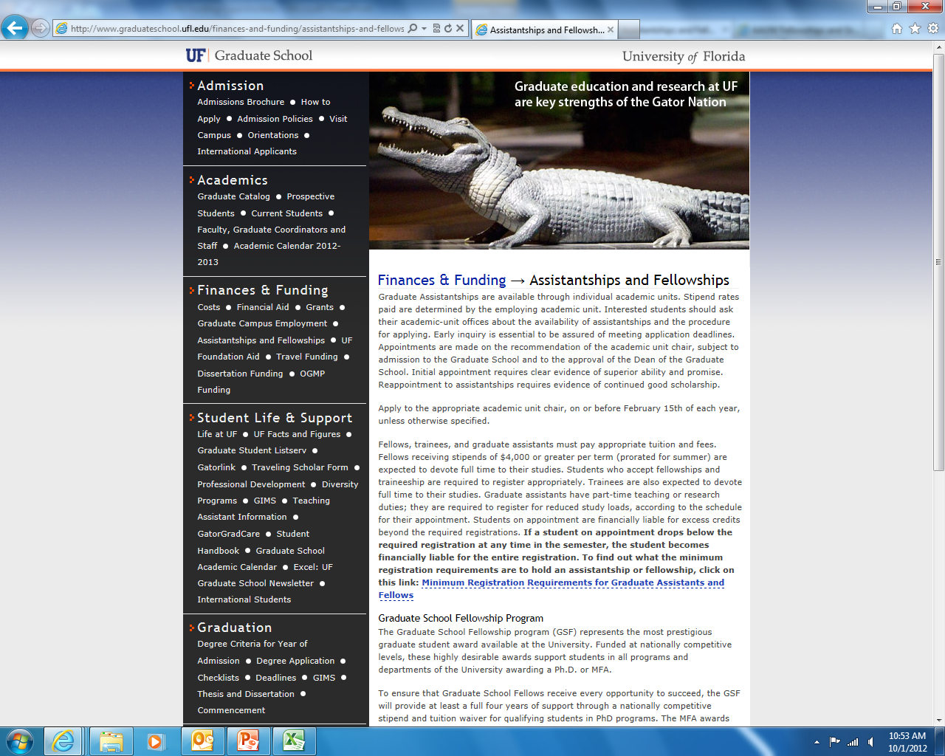
GRADUATE SCHOOL: ASSISTANTSHIPS + FELLOWSHIPS
Graduate Assistantships and Fellowships are available through individual academic units and decided upon admission into the program
Positions and stipend rates are determined by each academic unit
For students applying to GA, TA, and fellowship positions, simply check the appropriate boxes in the online application (no additional essay or application is necessary)
http://www.graduateschool.ufl.edu/finances-and-funding/assistantships-and-fellowships
Notes:
Applicable financial aid found outside UF (from the Grad School website)

Slide 5
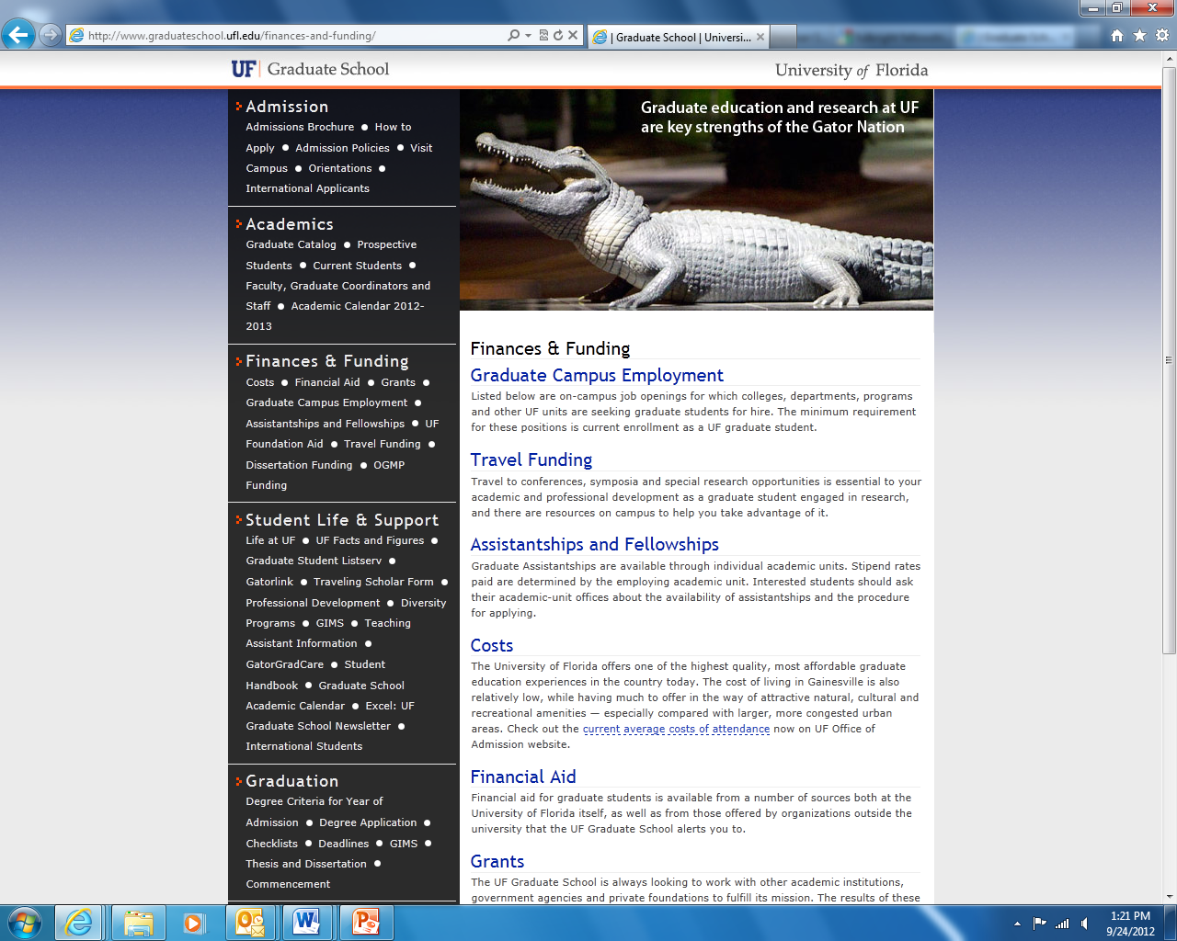
GRADUATE SCHOOL: FINANCIAL AID OUTSIDE UF
Some of the funding opportunities listed:
AAUW Financial Aid for Female Graduate Students
Charlotte W. Newcombe Doctoral Dissertation Fellowships
Delores Auzenne Dissertation Award
Ford Foundation Predoctoral Diversity Fellowships
Paul and Daisy Soros Fellowships for New Americans
http://www.graduateschool.ufl.edu/finances-and-funding/
Notes:
Applicable financial aid found outside UF (from the Grad School website)

Slide 6
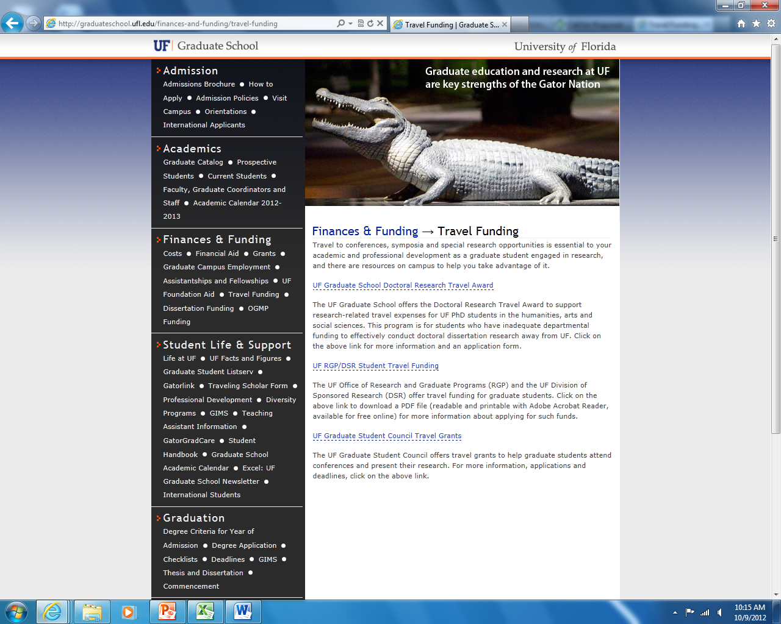
GRADUATE SCHOOL:
TRAVEL FUNDING
Some of the funding opportunities listed:
UF Graduate School Doctoral Research Travel Award
UF Office of Research and Graduate Programs (RGP) and UF Division of Sponsored Research (DSR) Travel Funding
UF Graduate Student Council Travel Grant
Departmental travel grants
http://graduateschool.ufl.edu/finances-and-funding/travel-funding

Slide 7
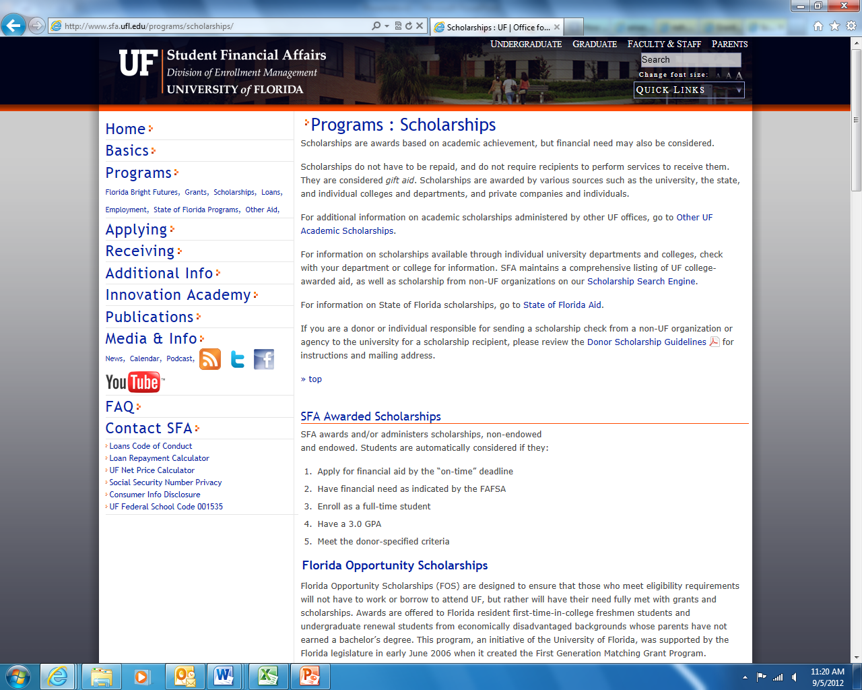
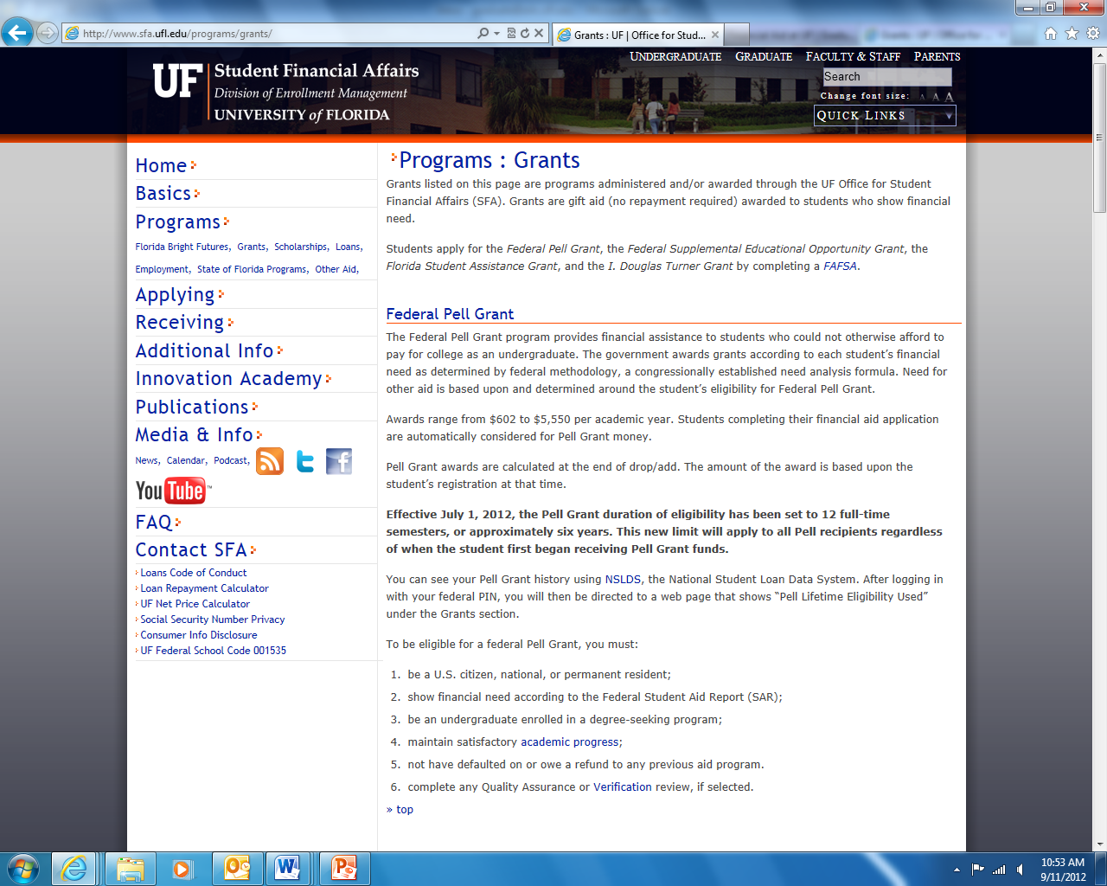
STUDENT
FINANCIAL AFFAIRS:
GRANTS + SCHOLARSHIPS
UF Graduate Grant
Endowed Scholarships
Non-Endowed Scholarships
http://www.sfa.ufl.edu/programs/grants/
http://www.sfa.ufl.edu/programs/scholarships/

Slide 8
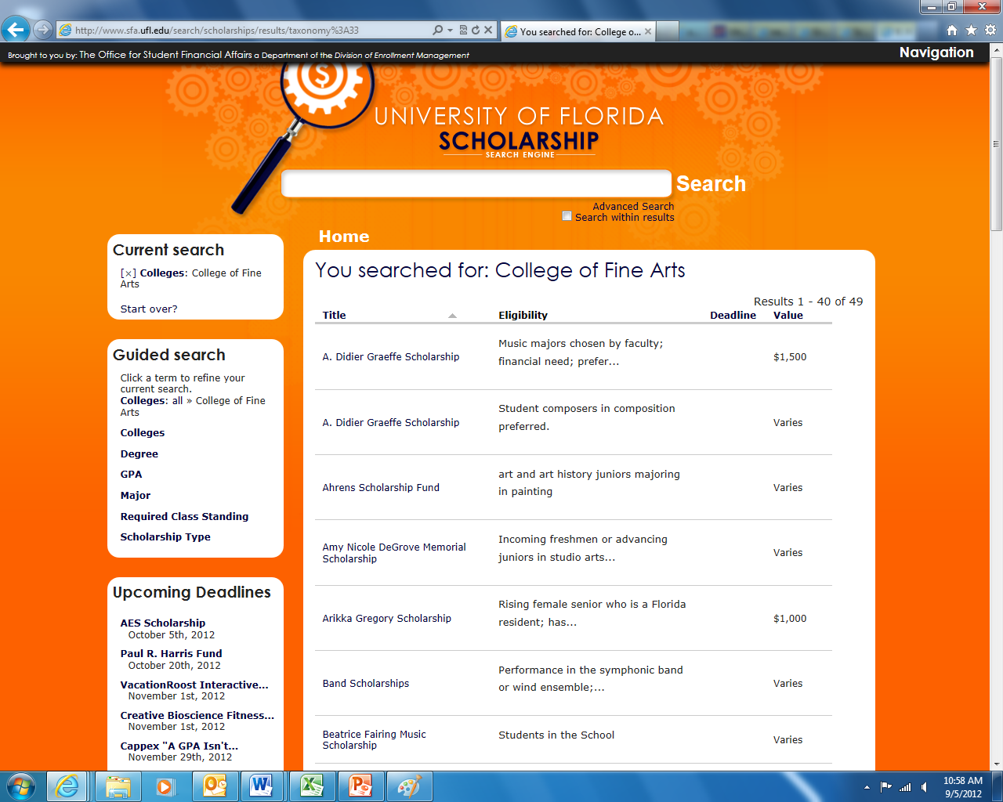
SCHOLARSHIP SEARCH ENGINE:
BY COLLEGE
Some of the funding opportunities listed:
Dennis and Colette Compay Studio Art Scholarship
David L. Wilmot Prize for Excellence in Music Education Scholarship
Ethel L. Ingraham Theatre Scholarship
Depending on the department, students submit an application or students are nominated by faculty
http://www.sfa.ufl.edu/search/
Notes:
Search by college (fine arts) and then by degree (graduate)

Slide 9
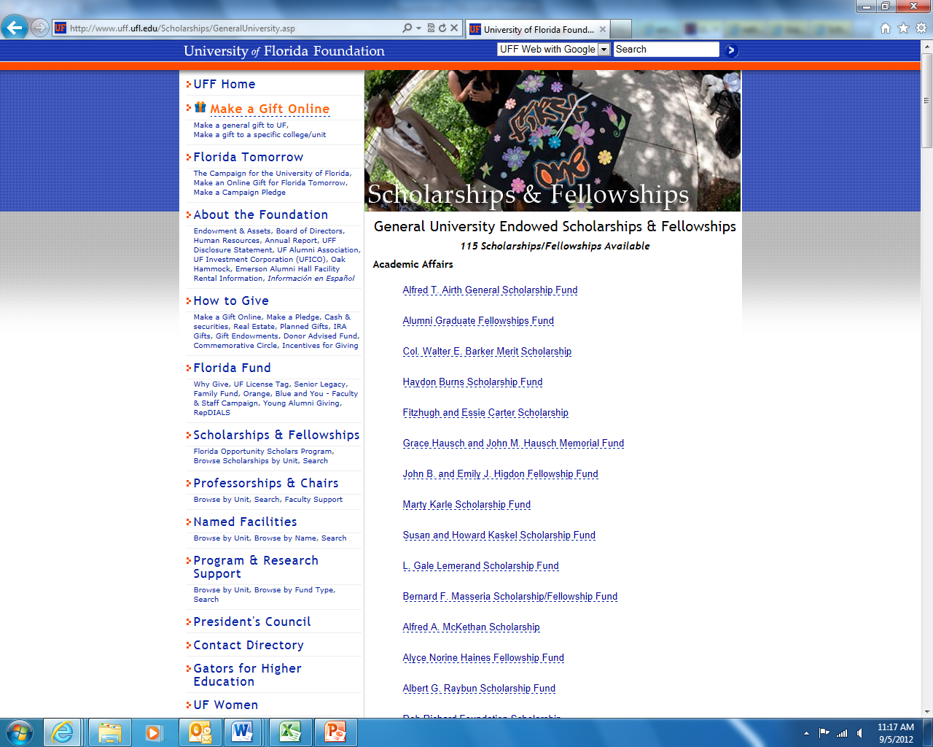
UF FOUNDATION:
BY ACADEMIC UNIT
Some of the funding opportunities listed:
James J. Rizzi Scholarship
Mr. and Mrs. John V. D’Albora Jr. Scholarship in Honor of Frances M. Reitz
Friends of Theatre and Dance Scholarship
http://www.uff.ufl.edu/Scholarships/ScholarshipsByUnit.asp?Unit=FA

Slide 10
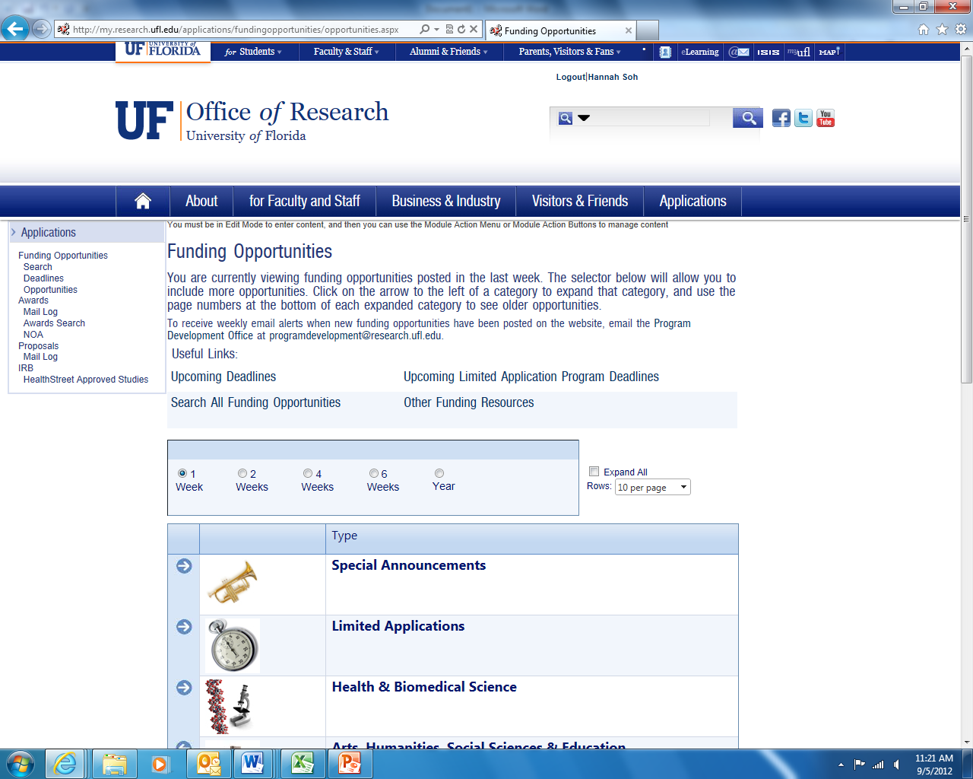
OFFICE OF RESEARCH:
BY CATEGORY
Some of the funding opportunities listed:
Council of American Overseas Research Center’s Multi-Country Research Fellowship
Rockefeller Foundation’s Bellagio Arts & Literary Arts Residency
http://my.research.ufl.edu/applications/fundingopportunities/opportunities.aspx

Slide 11
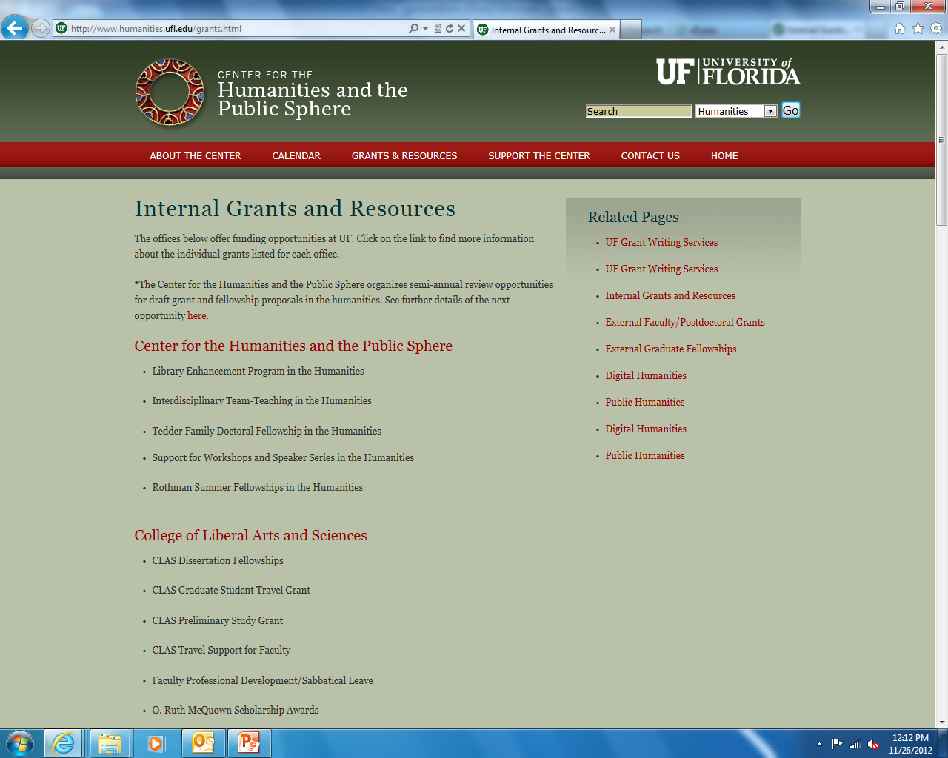
CENTER FOR THE HUMANITIES AND THE PUBLIC SPHERE
http://www.humanities.ufl.edu/grants.html

Slide 12
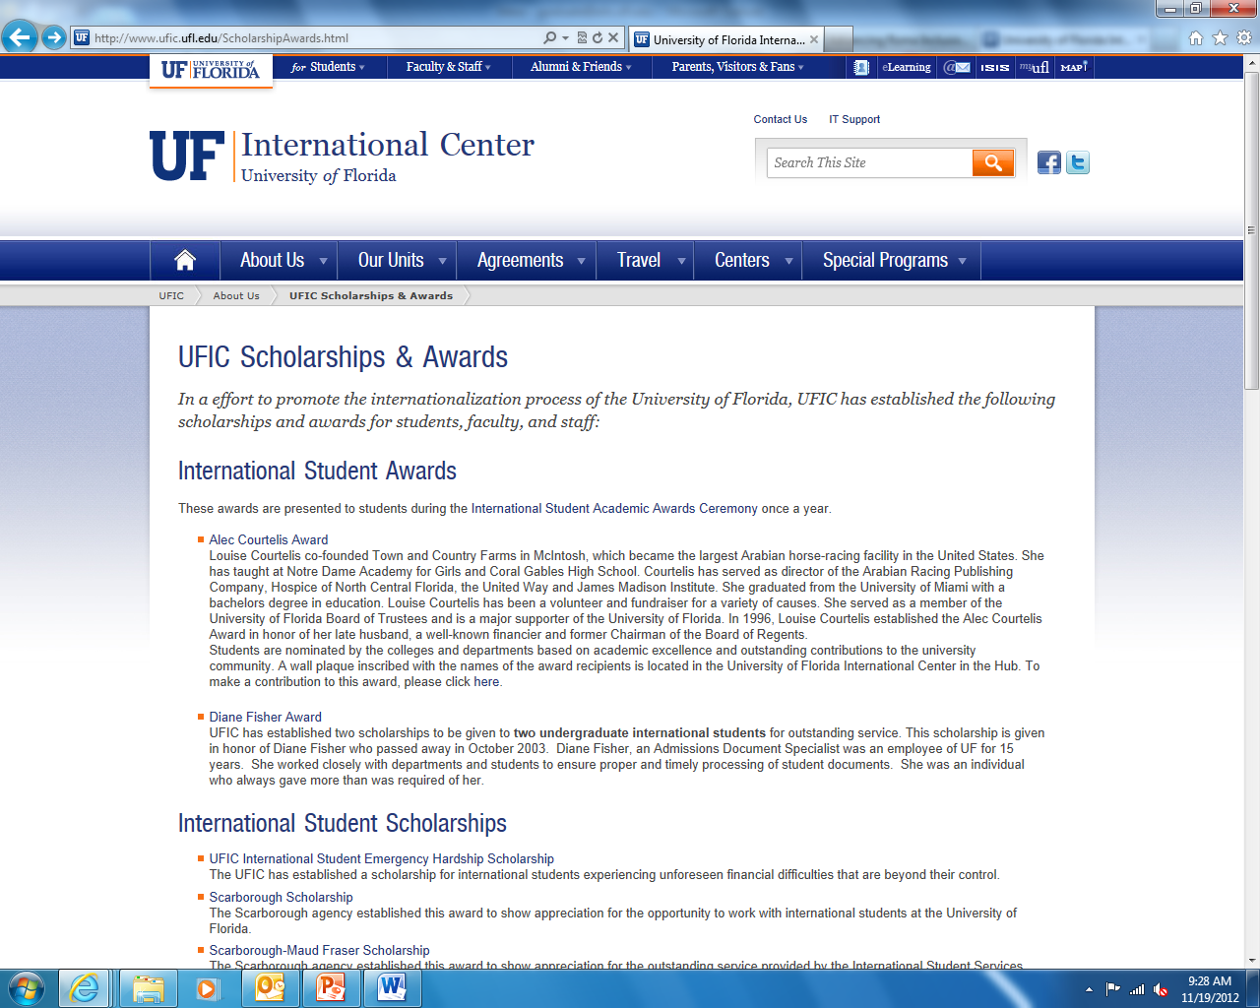
INTERNATIONAL
AWARDS
Some of the funding opportunities listed for master’s/PhD students:
Alec Courtelis Award
Scarborough Scholarship
Scarborough-Maud Fraser Scholarship
UFIC Annual Global Culture Photography Competition
http://www.ufic.ufl.edu/ScholarshipAwards.html

Slide 13
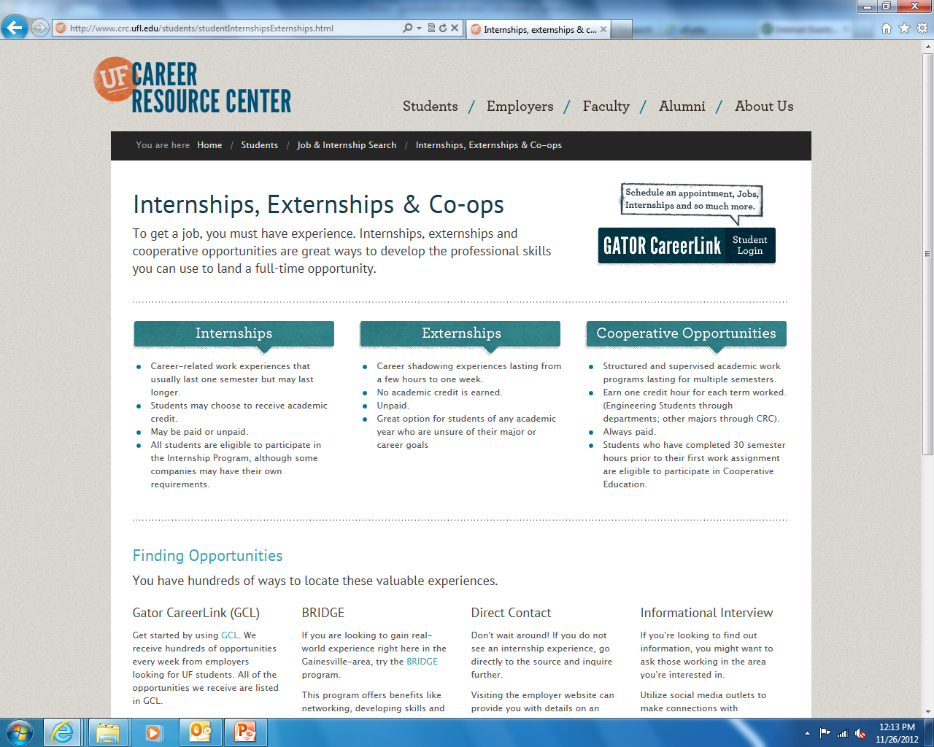
Don’t forget about internships!
http://www.crc.ufl.edu/students/studentInternshipsExternships.html

Slide 14
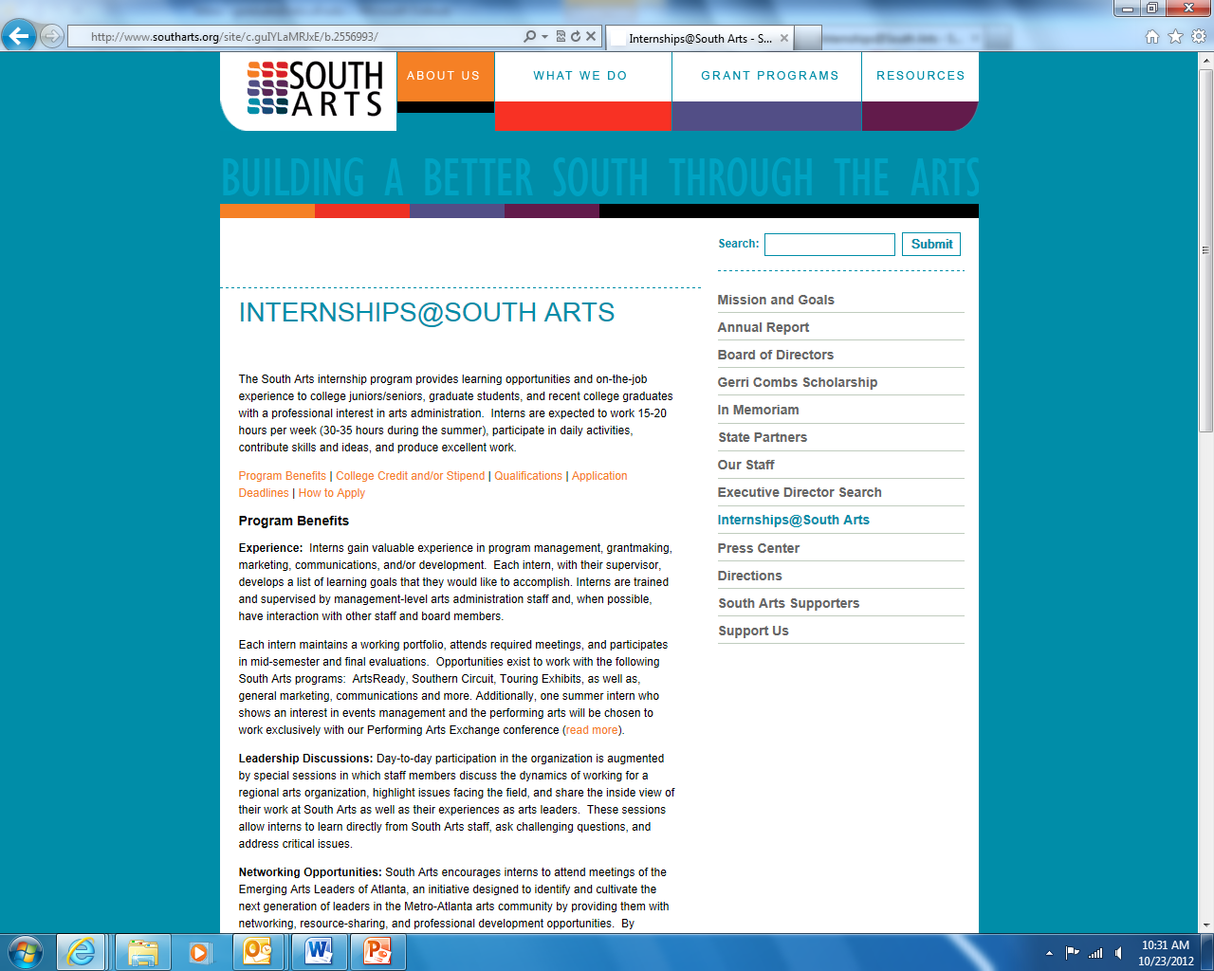
INTERNSHIPS
Internal internships:
Marshall Criser Internship
Robert Langley Internship
External internships:
South Arts
Harn: www.harn.ufl.edu
South Arts: http://www.southarts.org/site/c.guIYLaMRJxE/b.2556993/k.7BCE/InternshipsSouth_Arts.htm

Slide 15
grants AND fellowships in the arts

Slide 16
Foreign language and area studies (flas) fellowship
The Center for European Studies (CES) awards annual Foreign Language and Area Studies (FLAS) fellowships, which are funded by the US Department of Education (USDOE) under Title VI of the Higher Education Act. Only US citizens and permanent residents are eligible to apply for this fellowship. Applicants must be currently enrolled or accepted to a degree program at the University of Florida. In exceptional cases funding may also be available to support advanced language training in French, German or Spanish at the graduate level. Available for both the academic year and summer semester.
Award: $15,000 for academic year; $2,500 + $5,000 tuition waiver + up to $1,000 travel for summer
Center field research grant
The Center for Latin American Studies sponsors a Field Research Grant Competition to support graduate student research in Latin America and the Caribbean. Research in the United States on a Latino Studies topic and research in Spain or Portugal on some aspect of Latin America are also supported. The competition is open to graduate students from across the University of Florida campus. Support is available for Master’s thesis research and preliminary doctoral dissertation field visits. Recipients must spend six weeks in the field.
Award: typically between $500 and $2,000 each
FLAS: http://www.ces.ufl.edu/FLAS/index.shtml
Center Field: http://www.latam.ufl.edu/Funding/field.stm

Slide 17
FULBRIGHT
The Fulbright U.S. Student Program provides grants for individually designed study/research projects or English Teaching Assistantships. Academic research/study grants are available in approximately 140 countries. Applicants for these grants design their own projects and will typically work with advisers at foreign universities or other institutes of higher education. Projects in the Creative and Performing Arts and Creative Writing are research/study grants where the primary purpose of the grant is to learn an art form and/or create artistic work.
Award: varies
MCKNIGHT fellowship
The McKnight Doctoral Fellowship program is designed to address the under-representation of African American and Hispanic faculty at colleges and universities in the state of Florida by increasing the pool of citizens qualified with Ph.D. degrees to teach at the college and university levels. This is for current master’s students applying for PhD.
Award: annual tuition up to $5,000 and annual stipend up to $12,000
Fulbright: http://us.fulbrightonline.org/ and http://fulbright.state.gov/
McKnight: http://www.fefonline.org/mdf.html

Slide 18
The king award
The King Award for Young Artists National Music Competition rotates between piano and strings. The King Award recipient will be selected solely through a DVD screening process. (There will be no on-site Competition). Contestants must be at least 18 years of age, but not more than 26 years of age, as of March 15, 2013, and must be currently studying in the United States.
Award: $5,000 and performance with Salina Symphony
Bmi foundation, inc.
The BMI Foundation, Inc., a not-for-profit corporation founded in 1985, is dedicated to encouraging the creation, performance and study of music through awards, scholarships, internships, grants, and commissions. Applicable scholarships: BMI Student Composer Awards, Charlie Parker Jazz Composition Prize, John Lennon Scholarships, peermusic Latin Scholarships, Women’s Music Commission, Woody Guthrie Fellowship Program
Award: varies
King: http://www.king-award.org/index.html
BMI: http://www.bmifoundation.org/

Slide 19
Open society foundation
Asian cultural council
The Asian Cultural Council supports international dialogue, understanding, and respect through cultural exchange and nurtures the individual talents of the artists and scholars in Asia and the United States. The Asian Cultural Council grants are open to citizens and permanent residents of the United States or citizens and permanent residents of the countries of Asia, from Afghanistan eastward through Japan and Indonesia.
Award: varies
The Arts and Culture Program works at the nexus of arts, culture, human rights, and social advocacy. Through its grants, the program strives to encourage broad-based critical reflection and catalyze social action in parts of the world where open societies are absent or weak, and where the cultural rights of minority groups are endangered. Applicable programs: “Advancing Roma Inclusion through the Arts” and “Strengthening Civil Society through Arts and Culture”
Award: ranges from $25,000-$30,000
ACC: http://www.asianculturalcouncil.org/apply
Open Society: http://www.opensocietyfoundations.org/about/programs/arts-culture-program

Slide 20
Smithsonian institution fellowships
As part of its mandate for "the increase and diffusion of knowledge," including the diverse ideas, skills, and cultures of our nation, the Smithsonian Institution pursues policies of equal opportunity and cultural diversity. Smithsonian fellowships and internships are awarded on the basis of these policies. Fellowships at the Smithsonian Institution provide opportunities for graduate and postdoctoral students to pursue independent research while working with Smithsonian scholars and collections.
Award: varies
The getty fellowships
Pre- and Postdoctoral Fellowships are intended for emerging scholars who are working on projects related to the Getty Research Institute's annual theme. Two postdoctoral fellowships, supported by the National Endowment for the Humanities (NEH) were added to the existing program in 2011, and the Volkswagen Foundation, in cooperation with the Getty Research Institute, will provide up to two postdoctoral fellowships for the 2013-2014 scholar year. Library Research Grants provide partial, short-term support for scholars whose research requires use of collections housed in the Getty Research Institute.
Award: varies
SI: http://www.si.edu/OFI/index
Getty: https://www.getty.edu/foundation/funding/residential/

Slide 21
Newberry library short-term fellowships
Short-term fellowships are generally restricted to post-doctoral scholars, PhD candidates, or holders of other terminal degrees who live and work outside of the Chicago area and who have a specific need for Newberry collection. These fellowships require residency at the Newberry, unless otherwise noted. Some fellowships are open to other categories of applicants and Chicago residents. The tenure of short-term fellowships is one continuous month, unless otherwise noted. Scholars who have an extensive need for use of the collections may request two months of fellowship support.
Award: $2,000 per month
Dumbarton Oaks Fellowship Program
Dumbarton Oaks offers residential fellowships in three areas of study: Byzantine Studies (including related aspects of late Roman, early Christian, Western medieval, Slavic, and Near Eastern studies), Pre-Columbian Studies (of Mexico, Central America, and Andean South America), and Garden and Landscape Studies. Applicable programs: Junior Fellowships and Summer Fellowships
Award: varies
Newberry: http://www.newberry.org/short-term-fellowships
Dumbarton: http://www.doaks.org/research/fellowships-and-grants

Slide 22
Jack kent cook graduate arts award
The Jack Kent Cooke Foundation's Graduate Arts Award enables students or recent alumni with exceptional artistic or creative promise and financial need to pursue up to three years of study at an accredited graduate institution in the US or abroad. Students in the following disciplines are eligible to apply: performing arts, visual arts, and creative writing. Students must be nominated by their undergraduate institutions. They cannot apply directly. Each accredited four-year college or university may nominate two candidates.
Award: up to $50,000 annually
AAUW International fellowship
International Fellowships are awarded for full-time study or research in the United States to women who are not U.S. citizens or permanent residents. Both graduate and postgraduate studies at accredited U.S. institutions are supported. Applicants must have earned the equivalent of a U.S. bachelor's degree and must have applied to their proposed institutions of study by the time of the application. Up to five fellowships are renewable for a second year
Award: $18,000-$20,000
Newberry: http://www.newberry.org/short-term-fellowships
BMI: http://www.bmifoundation.org/

Slide 23
Grant proposal writing tips

Slide 24
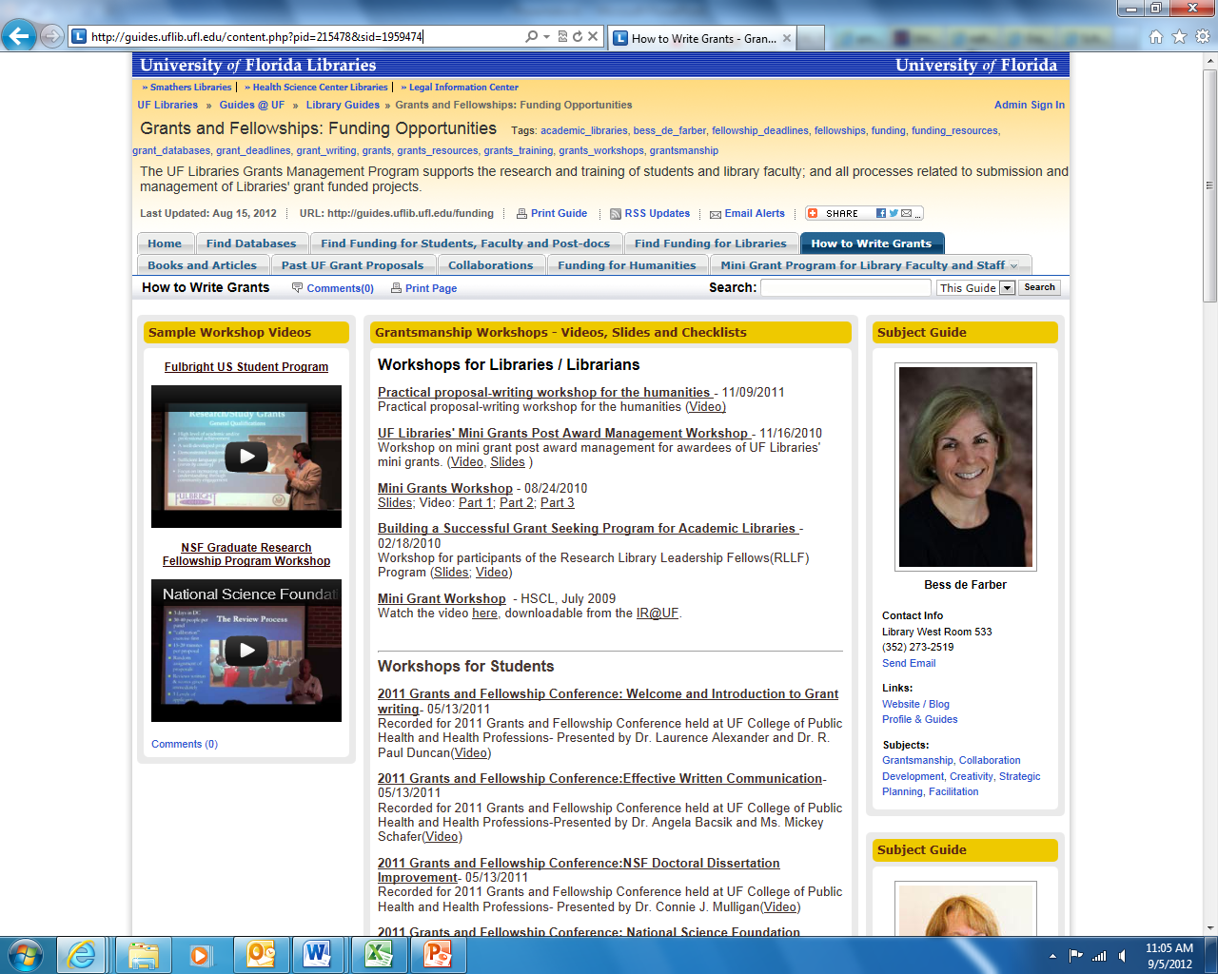
UF LIBRARIES:
GRANTS MANAGEMENT PROGRAM
How to Write Grants:
Past Grants and Fellowships Workshops
Find Funding for Students, Faculty and Post-docs:
List of Fellowship Deadlines and Funding Opportunities
Past UF Grant Proposals:
Proposals in the UF Institution Repository
http://guides.uflib.ufl.edu/content.php?pid=215478&sid=1792813

Slide 25
preparation
Define your project
Clarify the purpose of your project
Define the scope of your work
Determine broad goals/specific objectives
Identify the right funding sources
Contact the funders
Identify a project officer who will address your questions
Request proposal guidelines
Inquire about how proposals are reviewed and how decisions are made
Inquire about maximum funding support and budgetary requirements/preferences
Read the guidelines carefully, and read them again
Know the submission deadline
(From CPB: http://www.cpb.org/grants/grantwriting.html)
Decide who will benefit
Draft expected outcomes
Draft a timeline

Slide 26
Writing the proposal
Narratives
Statement of need- purpose, goals, measureable objectives, compelling reason
to support proposal
Approach- method and process of accomplishing goals/objectives, description
of intended scope of work and expected
outcomes, outline of activities
Method of evaluation
Project timeline
Credentials
Budget
Supporting Materials
Authorized Signatures
Specifications

Slide 27
Tips on Writing the proposal
Tips on writing the narrative
Think about the following questions:
What do we want?
What concern will be addressed and why is it important?
Who will benefit and how?
What specific objectives can be accomplished and how?
How will the results be measured?
How does the funding request relate to the funder’s purposes/objectives?
Who are we and how do we qualify to meet this need?
The HOOK

Slide 28
Before writing the proposal
Quickly determine feasibility of the idea for a specific funding opportunity. As described by Bess de Farber (UF Libraries Grants Manager), this is achieved by creating a rough timeline of all activities necessary to execute the project and then developing a budget to resource the activities, based on the sponsor's allowable and dis-allowable funding guidelines. If there is synergy, then proceed.
Learn as much as you can about the agency/program to which you are applying. This may involve navigating the funding body’s website to locate mission statements, press releases, annual reports, and related materials. *Look, in particular, at what kinds of projects have been previously funded.
Locate and study any reviewing criteria, and familiarize yourself with the funding agency’s peer-review process if it is made public. Where possible, take advantage of the availability of Program Officers to ask questions or discuss your proposal. Your department Development Officer may also be able to interpret the goals and preferences of private foundations, and Proposals Processing (in the Office of Research) can help you interpret grant guidelines.
Then, contact one of the following offices to alert them to your plan to apply for funding:
For opportunities at corporate, private, and family foundations, contact Bess de Farber.
For government funding opportunities, email ufproposals@ufl.edu to reach Proposals Processing in the Office of Research. Contact them early on to get guidance on preparing and submitting your proposal.
http://www.humanities.ufl.edu/grant-writing.html

Slide 29
Tips on writing the proposal
Write for a non-expert (i.e., write clearly, making use of introductory overview paragraphs).
Describe realistic amounts of work during the grant/fellowship tenure, and ask for correspondingly realistic amounts of money and time. Avoid “biting off too much” to attract many different reviewers.
Showcase explicitly the originality of your idea and the “need” in the field.
Demonstrate a thorough knowledge base, including a critical mass of publications and conference papers on the subject or a related subject.
Demonstrate an awareness of important resources for accomplishing the project, as well as possible problems that may emerge and plans for dealing with them.
Balance and dialogue between discussions of theory/problem and data/observations.
Avoid applying for grants for next projects if your current project is not near completion.
While focusing on the current project, identify some project outcomes and future directions that go beyond your immediate research or proposed publications. Take such questions seriously rather than as an afterthought in your proposal.
Think creatively and broadly about “broader significance” or “impacts”. These can include a variety of activities, including in your teaching, establishing a Web site or digital resource, publishing your findings in another country to foster better relations/collaboration, outreach, etc. In some cases (e.g., the NSF), broader impacts need not draw directly on the proposed research project, but can concern the disciplinary area writ large.
Choose referees carefully. Look for references who are full professors (at least two) who have a good understanding of the significance of your work, ideally (but not necessarily) someone who has previously received funding from the agency. Use referees to address gaps in your C.V. (e.g., referees can demonstrate that younger scholars show “great promise” in lieu of extensive publications). Avoid asking dissertation advisers if you are more than a few years past your doctorate, and use conferences as an opportunity to network with senior scholars who may have cited or reviewed your work in scholarly publications.
http://www.humanities.ufl.edu/grant-writing-tips.html

Slide 30
tips from mackenzie ryan
1. START EARLY. I begin searching for possible funding sources in May and June, knowing full-well that applications deadlines are usually in the fall. Summer really is your time to begin drafting proposals, editing your CV, and assessing your eligibility for funding sources. Chase down every lead you can; I tried numerous keyword searches, asked people ahead of me in the department or field, stalked listservs and professional organization websites in my field, and found online message boards dedicated the application process (there are specific ones for Fulbright and Fulbright-Hays, but Academic Jobs Wiki: Dissertation Fellowship provides an extensive list).
2. DEADLINES ARE YOUR FRIENDS. Whether you love them or hate them, deadlines are great motivators. I'm famous for my spreadsheets, listing the requirements for applications in order of their deadlines. If you've thought broadly about your research project in the summer and drafted your ideal narrative, it will be much easier to tailor your project to the specific demands or leanings of different sources in the weeks leading up to the deadlines.
3. ASK NUMEROUS PEOPLE TO READ YOUR DRAFTS. First, this forces you to get your proposal to a stage where you are actually confident enough to show someone! Second, by nature of these projects, you are too close to your project to assess whether you are articulating your thoughts clearly. My most helpful critiques came from my retired aunt and uncle. When they had trouble understanding something, I understood I had taken a leap or not effectively fleshed something out. They also had ample time and compassion for me, both advantages! Your advisor will of course read through a draft or two, but he or she likely will not hold your hand; nor will he or she thank you for asking them to read a very rough draft. Use your experts, but remember their time is precious!

Slide 31
tips from mackenzie ryan
4. APPLY WIDELY, BUT ONLY FOR THINGS TO WHICH YOU ACTUALLY QUALIFY. Send emails to inquire about your eligibility if you are unsure. Sometimes you'll hear good news (yes, apply!) and sometimes you won't, but at least you won't have taken the time applying to something you are not even eligible to receive. For my dissertation fieldwork, I applied to six (four rejections, one alternate, one small success!). For my final year of dissertation writing, I applied to six (four rejections, one small success, one large success!). And don't be overly discouraged. Sometimes your project just isn't what they are looking for, and sometimes they entirely misunderstand what your project is about. Sometimes you'll get mixed reviews, too. Do request your readers' comments and take them into account for the next round (because there is always another round of applications!).
5. TAKE ADVANTAGE OF UNIVERSITY FUNDING AND UNIVERSITY SERVICES. I enrolled in the history department's grant proposal 'boot camp' two years ago. I see that the university is offering blind reviews of grant proposals--stellar! Small pots of money are also available, depending on your project, your degree, and your college. It is up to you to go after them. Remember, this is your project, your degree, and after all, money in your pocket, so if you are waiting for someone to present you with a to-do list tailored to applications to which you qualify, you will be waiting forever.

Slide 32
Need more help?
Bess de Farber
UF Libraries’ Grants Manager
Library West Room 533
352-273-2519
bdefarber@ufl.edu
Margaret Mertz
Associate Dean of Research, Technology, and Administrative Affairs
Dean’s Office
352-273-1481
mmertz@arts.ufl.edu

